Slide 1
Data, Tools, and Technical Assistance for Cities on the Road to
100% Renewables
Elizabeth Doris, Principal Laboratory Program Manager: State Local and Tribal
San Francisco, 7/11/16
Notes:
1500 TA requests from jurisdictions since 2011
Over the last few years – major uptick in requests to us from cities

Slide 2
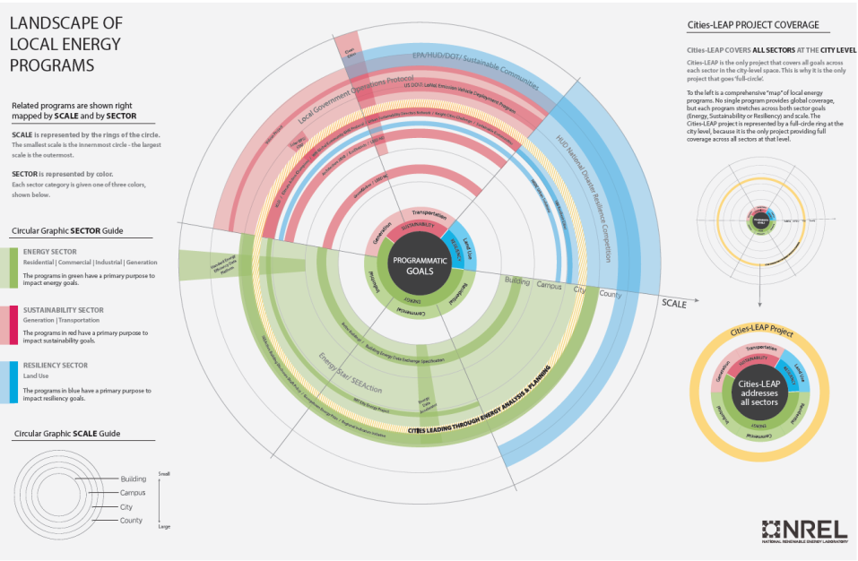
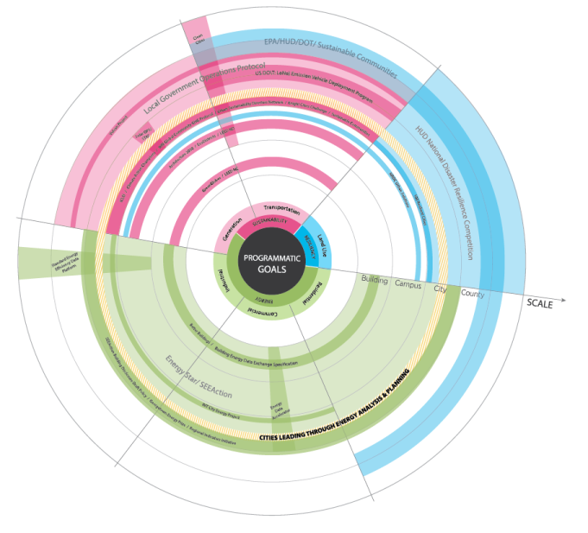
What’s Available for Support?
http://energy.gov/sites/prod/files/2015/04/f21/CLEAP_Programs_FINAL_0.PDF

Slide 3
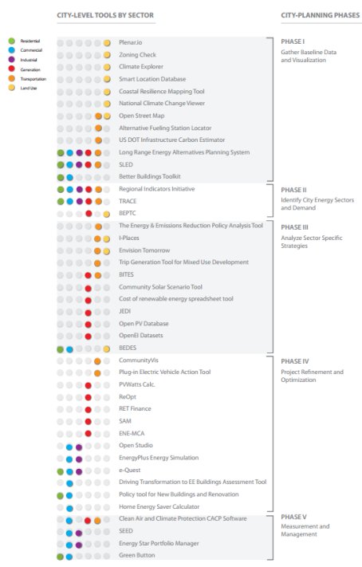
Tools, tools, tools
“Please Integrate”
http://energy.gov/sites/prod/files/2016/03/f30/CLEAP_Tools_v2016-3.PDF

Slide 4
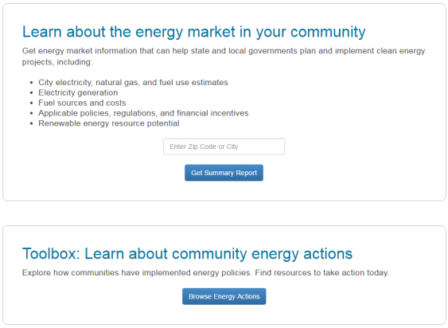
Data
CITY ENERGY PROFILES for 23,400+ U.S. Cities
Developed new, replicable methodology and estimated:
Electricity, natural gas, fuel consumption
Vehicle miles traveled
GHG Conversions
Provides actual data on:
Vehicle fuel types
Average fuel economy
Within weeks:
Rooftop PV potential
Building stock characterization
Industries by size and type
apps1.eere.energy.gov/sled

Slide 5
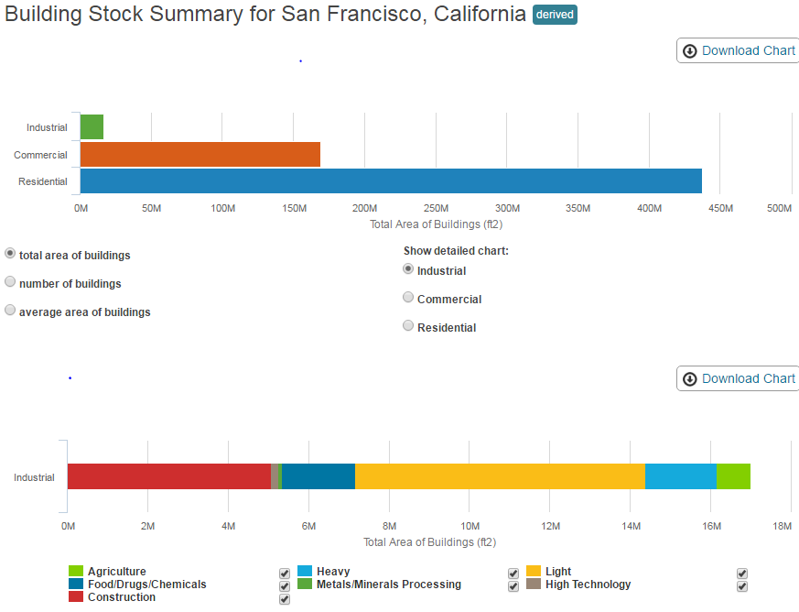
Data
CITY ENERGY PROFILES for 23,400+ U.S. Cities
Developed new, replicable methodology and estimated:
Electricity, natural gas, fuel consumption
Vehicle miles traveled
GHG Conversions
Provides actual data on:
Vehicle fuel types
Average fuel economy
Within weeks:
Rooftop PV potential
Building stock characterization
Industries by size and type
apps1.eere.energy.gov/sled

Slide 6
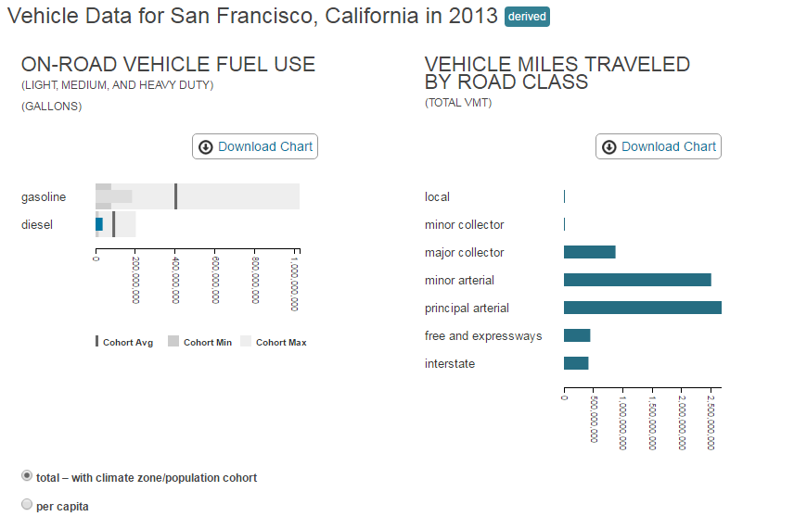
Data
CITY ENERGY PROFILES for 23,400+ U.S. Cities
Developed new, replicable methodology and estimated:
Electricity, natural gas, fuel consumption
Vehicle miles traveled
GHG Conversions
Provides actual data on:
Vehicle fuel types
Average fuel economy
Within weeks:
Rooftop PV potential
Building stock characterization
Industries by size and type
apps1.eere.energy.gov/sled

Slide 7
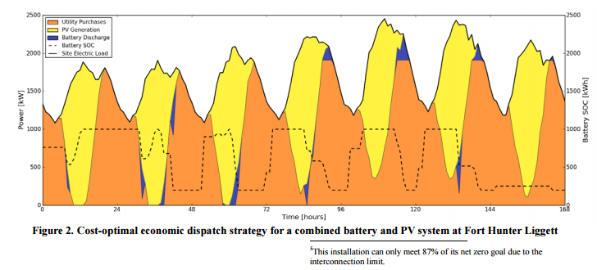
Tools
ReOpt: Technology Cost Optimization and Resiliency Quantification
http://www.nrel.gov/tech_deployment/tools_reopt.html
Notes:
ReOpt
SAM
dGen

Slide 8
Tools
https://sam.nrel.gov/

Slide 9
Technical Assistance
TECHNICAL ASSISTANCE
Wind Powering America/ WINDExchange
Office of Indian Energy/Tribal Energy Program
Clean Cities
Solar Technical Assistance Team
SolSmart

Slide 10
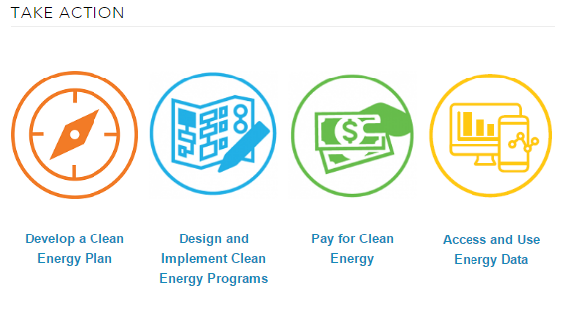
Research and Resources
http://www.nrel.gov/research/publications.html
http://energy.gov/eere/slsc/state-and-local-solution-center

Slide 11
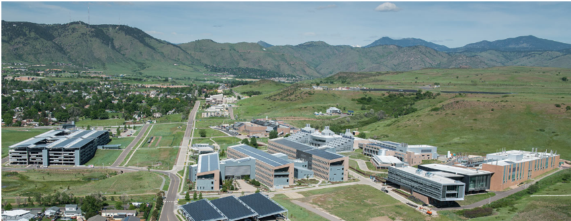
Thank You
Come Visit Us!
Search for “NREL Energy Executives”
Elizabeth.Doris@nrel.gov, (303) 384-7489

Slide 12
Cities Leading through Energy Analysis and Planning (Cities-LEAP)
FOUNDATIONAL RESEARCH
City-level Energy Decision Making: Data Use in Energy Planning, Implementation, and Evaluation in U.S. Cities
CITY ENERGY PROFILES for 23,400+ U.S. Cities
Developed new, replicable methodology and estimated:
Electricity, natural gas, fuel consumption
Vehicle miles traveled
Provides actual data on:
Vehicle fuel types
Average fuel economy
Coming this spring:
Rooftop PV potential
Building stock characterization
Industries by size and type
GHG conversions for each city
apps1.eere.energy.gov/sled
FUNDING OPORTUNITY ANNOUNCEMENT
Innovative approaches to incorporating energy data in city decision making
CITY ENERGY FUTURES
Aggregate, national economic and GHG impact of suites of city energy actions
Coming Sept. ‘16
to

Slide 13
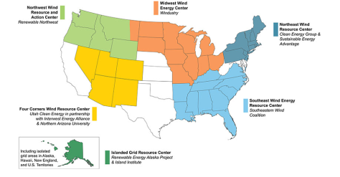
Wind Powering America/WINDExchange
Program Summary:
Assists regional stakeholders evaluate wind energy potential and impacts to the region
Six Regional Resource Centers
Notes:
The US Department of Energy launched Wind Powering America in 2000 back when there were only 2,500 MW of installed wind capacity in the United States. By Jan 2015 over 65,000 MW of installed wind capacity exist in the united states.
Of course we can’t attribute all of that capacity specifically to the Wind Program, but it is safe to say that the Wind Program has provided significant assistance and enabled the development of many wind projects within the United states
Today the program is called WINDExchange and is the U.S. Department of Energy Wind Program's platform for disseminating credible information about wind energy. The purpose of WINDExchange is to help communities weigh the benefits and costs of wind energy, understand the deployment process, and make wind development decisions supported by the best available information.
The technical assistance portion of WINDExchange is called the Regional Resource Centers which were established in 2014.
The goal of the DOE Regional Resource Centers project is to make it easier for stakeholders and decision-makers to decide whether responsible and appropriate wind project development is right for their communities
The resource centers provide regional stakeholders with information to familiarize the public with wind energy, raising awareness about potential benefits, and disseminating data on siting issues such as turbine sound and wildlife habitat protection.
Regional stakeholders may include: county commissioners, state legislators, landowners, tribal authorities, and organizations such as utilities, schools, and non-profit agencies
Each of the Resource Centers has very specific goals and projects aimed at the issues occurring within their region. For example, the Midwest Wind Energy Center covers 10 midwestern states with varying levels of wind expertise: some are leaders in the industry, and some of very limited markets. Therefore, the primary efforts at the Midwest center are to offer forums to share lessons learned among the states and to facilitate new collaborations among the states.

Slide 14
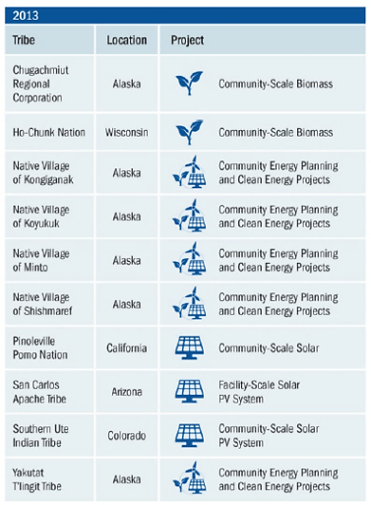
Office of Indian Energy/Tribal Energy
Program Summary:
Strategic Technical Assistance Response Team (START) / On-Response
Assists tribes in the 48 contiguous states and Alaska
Goal is to move projects closer to implementation
Types of Assistance: technology and resources, transmission, policy and programs
Notes:
NREL supports the DOE Office of Indian Energy and Tribal Energy technical assistance programs. Note that while these are different offices, they share many of the same goals and have programs that compliment each other well and are extremely well coordinated. Through these programs we provide:
strategic energy planning and project development technical assistance
Eligible parties are federally recognized Indian Tribes, tribal energy resource development organizations, and other organized tribal groups and communities to advance tribal renewable energy and energy efficiency projects.
The goal of the technical assistance is to address a specific challenge or fulfill a need that is essential to a current project’s successful implementation.
Through the DOE Office of Indian Energy’s Strategic Technical Assistance Response Team (START) Program launched in December 2011, NREL supports DOE efforts to empower tribal nations to tap into their clean energy resources by providing tribal communities with the tools and on-the-ground resources they need to lead strategic energy project development. Through START, Tribes in the 48 contiguous states and Alaska can apply for and are selected to receive technical assistance to move projects closer to implementation. Tribes that receive technical assistance through the START Program are selected based on capacity, commitment, and the maturity of their project(s).
Some of the successes this program have seen include:
Greatly improved the quality of the design for the biomass district heat system and increased tribal project team capacity to successfully integrate biomass into existing systems. (Chugachmiut Regional Corporation, Port Graham, Alaska)
Equipped the Tribe with the experience and expertise needed to make informed and defensible procurement decisions to move forward with securing a PPA for its PV project. (San Carlos Apache Tribe, Arizona)
Completed weatherization of the city/tribal office, with a projected energy savings of 53% or $13,000 annually. (Native Village of Koyukuk)
Again with this program, assistance is available on a year-round basis through a simple application. The goal here is to provide tribes with assistance at any stage along the project spectrum, from understand more about the technologies available, all the way to assistance in procurement.

Slide 15
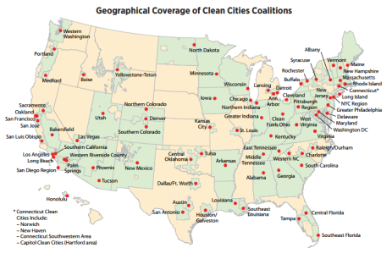
Clean Cities Tiger Teams
Program Summary:
Established in 1993 through the Energy Policy Act of 1992
Assists Clean Cities coalition coordinators, stakeholders and partners
Goal is to reduce petroleum consumption in transportation
Types of Assistance: fleet analysis, bidding and procurement assistance, reassurance of work performed to specifications, operations and maintenance issues
Notes:
Before I dive into the TA work, I want to provide a brief description of the Clean Cities program more broadly.
Clean Cities began in 1993 and is US Department of Energy Vehicle Technologies Office-funded program with a goal of reducing petroleum consumption in transportation through local action
Replace petroleum with alternative and renewable fuels
Reduce petroleum consumption through smarter driving practices and fuel economy improvement
Eliminate petroleum use through idle reduction and other fuel-saving technologies and practices.
Clean cities coalitions are composed of businesses, fuel providers, vehicle fleets, state and local government agencies, and community organizations and are located all across the United States
Each coalition has a Clean Cities coordinator who tailors projects and activities to take advantage of the unique opportunities in individual communities.
Tiger Teams work directly with those coordinators, stakeholders and partners to tackle difficult technical and market challenges that might otherwise stall alternative fuel vehicle implementation projects
The Tiger Teams TA takes a proactive and reactive approach to assistance:
proactive by filling resource and knowledge gaps based on what fleets are experiencing and working with industry to address common issues and avoid potential incidents
Reactive by helping individual stalled projects get back on track and providing neutral third party perspectives for conflicting information in the marketplace
Assistance is provided when coalitions encounter barriers and challenges, and the team can assist at any point in the project/product lifecycle from concept and development, to execution and operation, all the way to closure
Examples of projects include :
Technical Problem Solving – Vehicle Operations: Issues can pertain to vehicle performance, drivability, safety, maintenance, driver acceptance, training, or best practices for implementation of alternative fuel vehicles at specific sites.
Technical Problem Solving – Infrastructure Operations: Issues can pertain to fueling station design, siting, interaction with alternative fuel providers or fire safety code officials, fueling station performance, maintenance requirements, or user and operator training.
Evaluation of Project Potential: Some projects (including transit systems and airports) may qualify for technical assistance if expertise is not available from local or regional resources or stakeholders. When there is demonstrated local interest, a Tiger Teams expert can evaluate local market conditions, conduct infrastructure assessments, gauge stakeholder needs, and assist in defining project execution feasibility.
The Tiger Team has a number of ways to engage with stakeholders:
One on one phone and email consultation
On site visits
Referrals to existing resources
Creation of new reports, tools or resources of necessary
Clean Cities and Tiger Teams have significant resources for both the coordinators and the general public

Slide 16
SolSmart
Program Summary:
Launched April 2016
Designation program for local governments
Addresses solar soft costs (financing, permitting, zoning)
NREL is one of several TA providers

Slide 17
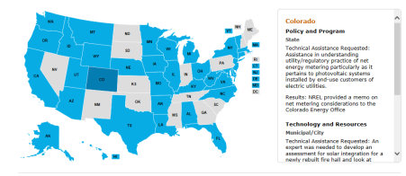
Solar Technical Assistance Team (STAT) Network
Program Summary
Assists state and local policymakers and staff
Supported over 80 jurisdictions since 2013
Topics covered: PV and storage, interconnection, Net Metering, Renewable Portfolio Standards and set asides, solar valuation methodologies, policy and regulatory interaction impacts, community solar, third party financing, property assessed financing, building codes, and consumer protection.
2016-2018 STAT partners:
Notes:
Talking points:
The Solar Technical Assistance Team, in its current format, began in 2013 and is supported through the Department of Energy Solar Energy Technologies Program
The goal of the STAT is to assist state and local decision-makers and their staff with their solar policy and program issues
This can be difficult at times, as the goal of the TA at NREL more broadly is to provide credible, neutral assistance, however it’s the nature of the Solar Program to be interested in increasing solar deployment. Therefore, the STAT program has a goal of helping policymakers with solar decisions, regardless of what that decision is. If information we provided is used in a decision making process, whether or not that is a pro-solar decision, we consider that a win in the program. It’s really the only way we can provide assistance and maintain our credibility.
Types of assistance provided includes
in depth analysis that can last up to 9 months
This generally includes a combination of already existing analysis from lab experts and new analysis targeted at the specific location requesting assistance. Generally a deliverable would include a white paper or a presentation in front of a group of decisionmakers
Quick response which is our quick turnaround program, requests that can be as little as a phone call to answer a fast question, or 80 hours of SME work to help answer a jurisdictions question. Here, presentations are king, as the deliverable is usually needed quickly and in an easy to digest manner. Quick response is where we most often assist with open dockets – we can be asked to speak as experts, or provide information to others during the hearing
DIY learning: we also have a very successful website with lots of pre-packaged information so people have the opportunity to learn on their own time. We know that decisionmakers are busy, and often need quicker snippets of information, rather than reading a long paper. At the website we have a TA map, which shows all of the locations we’ve assisted since 2012, what types of questions have been asked, and how we provided a response. We also have a blog with up to date, useful information, webinars, and a podcast series. What’s more, we’ve starting creating policy basics pages, which provides information on solar policies that are commonly asked about. Topics here include Value of Solar, Feed in Tariffs, and Renewable Portfolio Standards, among others. Again, the goal being to have timely, credible and digestible information, which is really the key emphasis here
On our website it is always possible to request assistance, if you’re a qualifying state or local decision-maker. We pride ourselves on a simple application that is submited to our email address: stat@nrel.gov. Don’t be fooled, there are real people behind that address – it is linked directly to the inboxes of myself and other key NREL staff, so you will receive a prompt response!

Slide 18
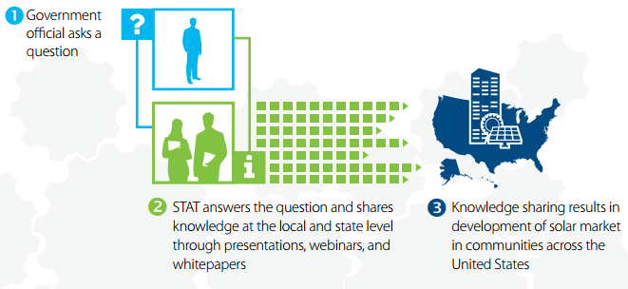
STAT TA: Summary
Source: NREL, 2016

Slide 19
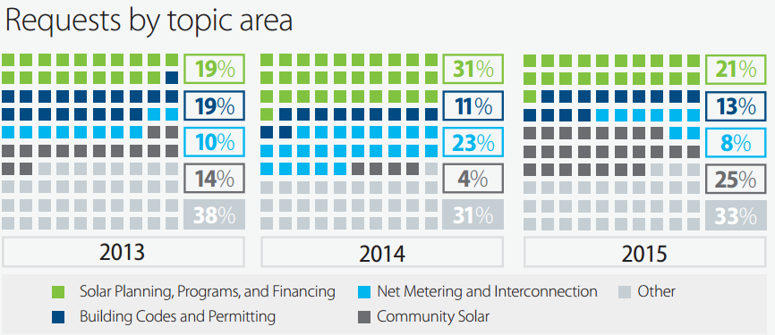
What are states and localities asking STAT?
Source: NREL, 2016

Slide 20
State TA: Direct, Quick Response
Applicants | Topic
City & County of Denver, Office of Economic Development | Solar contribution to NZE community, strategies
City of Camden, New Jersey | Solar on contaminated lands
City and County of Denver, Mayor’s Office | Solar Benefits technical support
Montana Senate District 33 | Solar Ready Design presentation
Delaware Public Service Commission | Technology – Inverter accuracy
County of Kauai, Hawaii | RFP Assistance
City of Chicago | Airport project technical support
Louisiana PSC | Net metering caps presentation
City of Tucson | Financing Options for PV
Ranson, WV | Policy Options
Austin Electric Utility Commission | Value of solar methodology
Program Structure
Rolling application throughout the year
Short online application
Quick turnaround time on request approval
Up to 40 hours per request
Notes:
ERIN: Talking Points:
The QR program is our rapid response TA program. It allows for policymakers and staff ask a wide variety of questions from technology questions all the way to policy and program design and impact questions.
This program is accessed by a short online application and provides for about 80 hours of assistance per request. Through a streamlined process, we can offer quick turnaround on approvals so that these requests are quickly in order to meet the requestors timeline
On the right side of the slide, you will see some of the applicants and topics of TA that has been provided through this program in the past year.
This Quick Response program has a rolling application throughout the year.
TRANSITION: if the request is not super time sensitive and requires a larger effort, we direct it to the In-Depth TA program….

