Slide 1
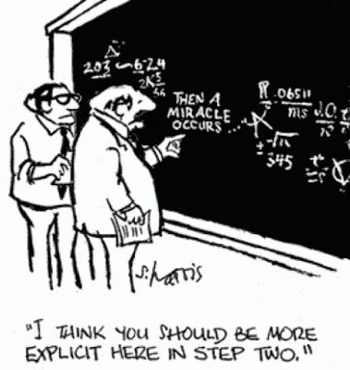
How are Cities Going to Get to 100% RE?

Slide 2
How are Cities Getting to 100% RE?
Have access to or convert to emissions-free sources
Electricity: Most often hydro
Thermal: Biogas DE (Copenhagen, London); electrification (Oslo, SF exploring)
Transportation: Electrification, biogas, hydrogen
Muni – greater control (but come with their own challenges)
But most don’t have access to either – dependent on decisions by IOUs, suppliers, other levels of government, regulatory agencies they don’t control
Electricity: Some control
Thermal: Less control
Transportation: Least control
Traditionally, these cities could not achieve 100% renewables unless these other entities strive for (or are mandated to achieve) the same goal
However, this conventional utility model is starting to change

Slide 3
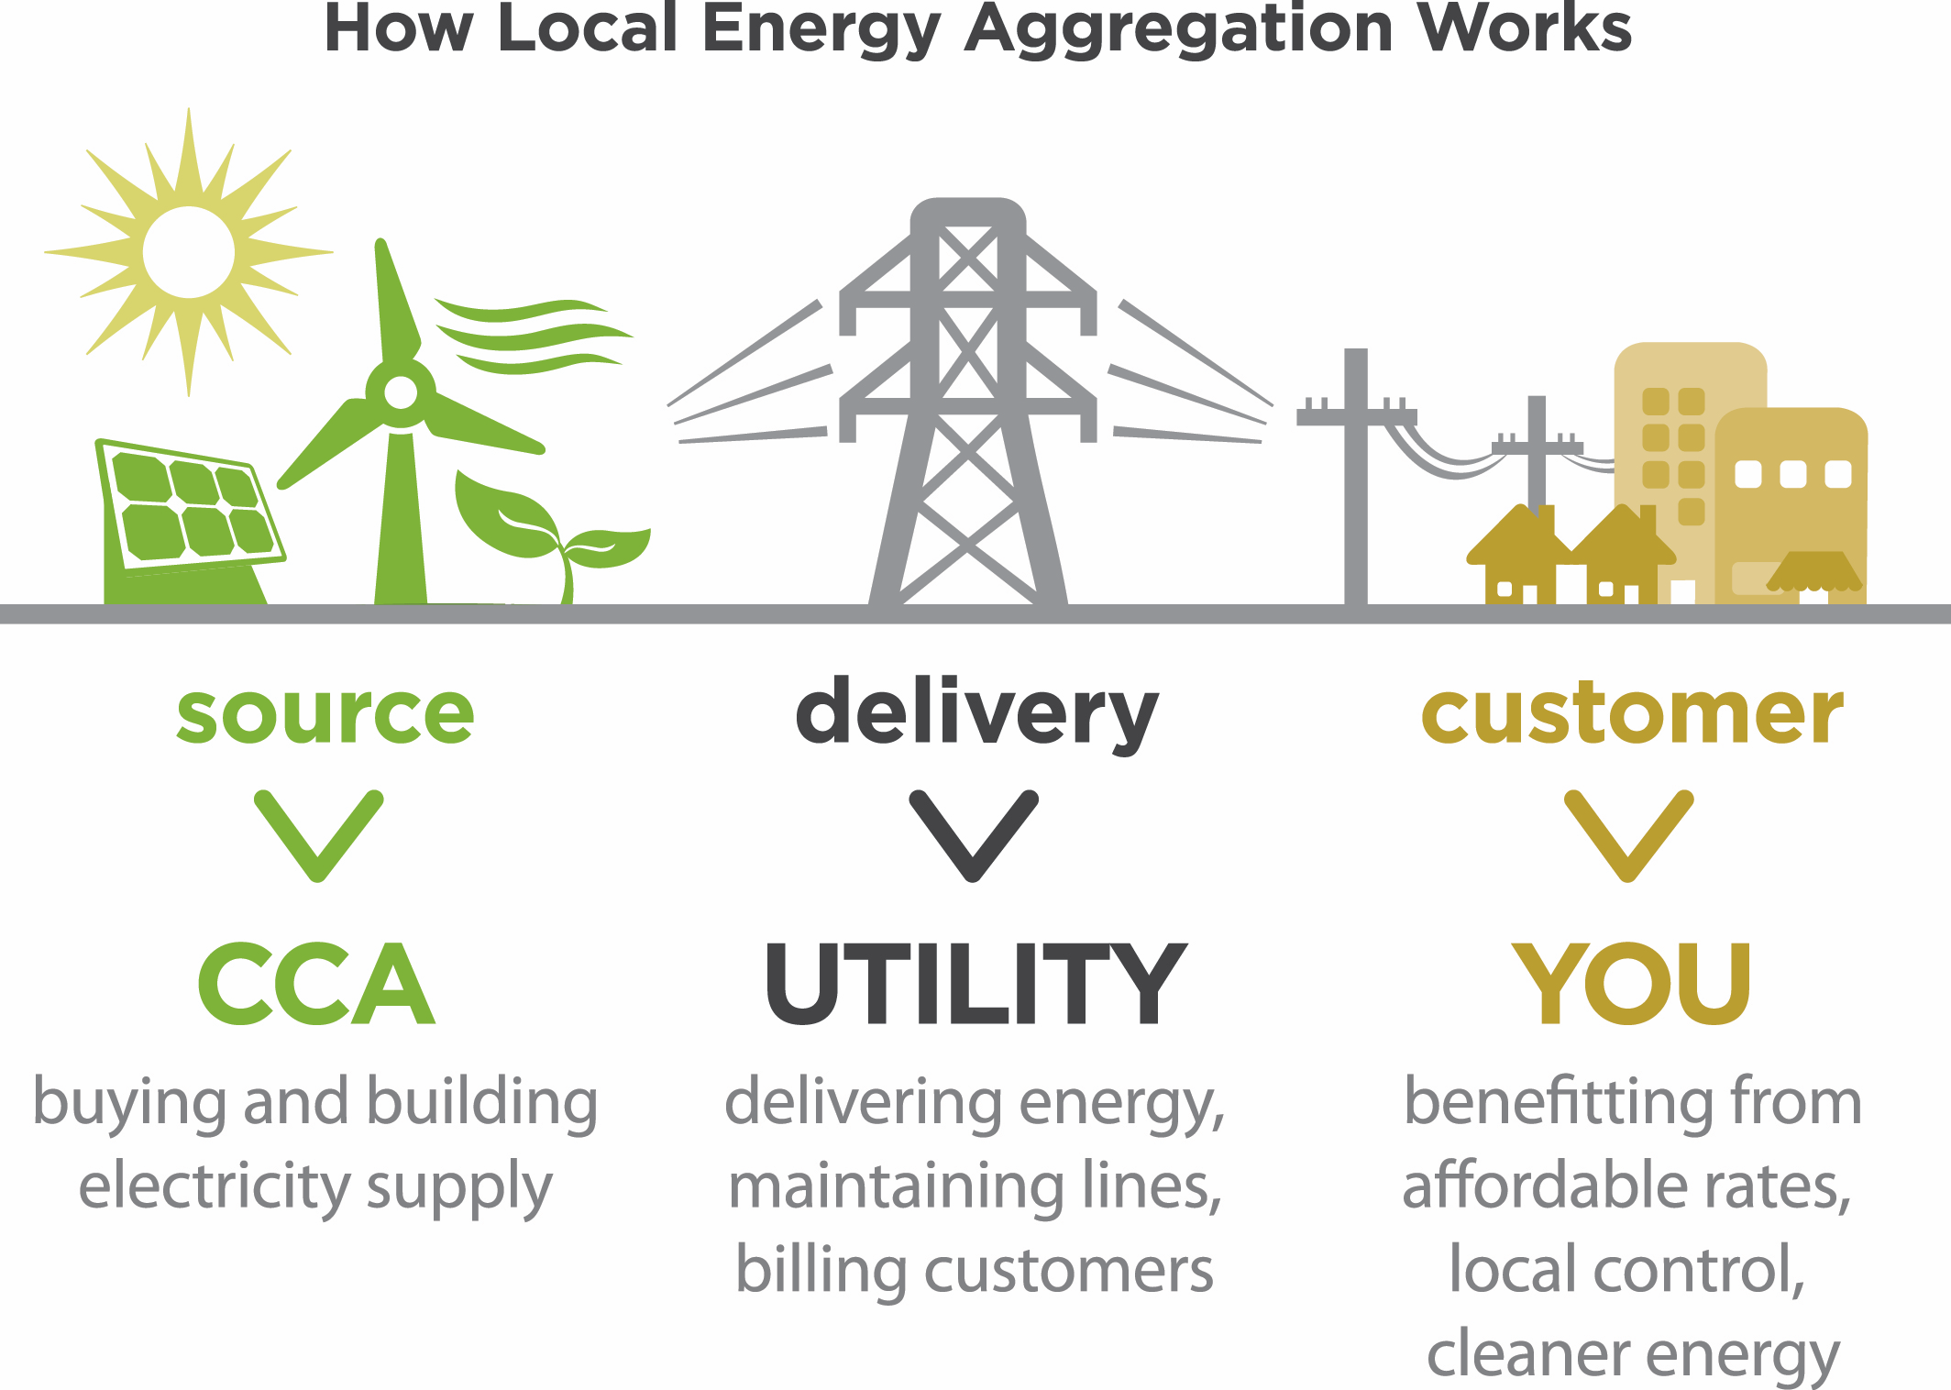
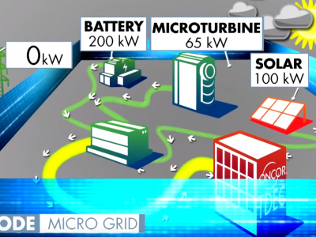
How are Cities Getting to 100% RE?
Some cities are starting to drive the redesigning of the conventional energy supply utility model, and creating a new vision for an energy system transformation
Municipalization (Sacramento, Boulder)
Community Choice Aggregation (Marin, SF, San Diego, San Jose, Chicago, Cleveland)
Allowed in: California, Illinois, Massachusetts, New Jersey, Ohio, New York & Rhode Island
States considering: Utah, Delaware & Minnesota
Decentralization via micro-grids, district heating & cooling, tri-generation (Sydney, Copenhagen, Boston, Yokohama)
Maximizing energy efficiency (LA), pooled large-scale RE purchases (Washington DC, Melbourne), distributed renewable energy systems

Slide 4
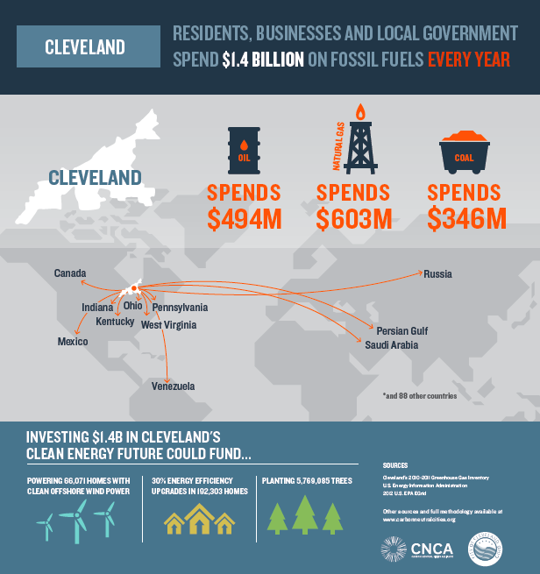
Resources/Tools
Tools/Resources:
Sierra Club/HereNow “American Views on 100% Clean Energy” national survey findings and messaging tips
ecoAmerica public opinion research data (~$2500/city)
CNCA Infographic (communicating/messaging tool) and the 100% Cities strategies being developed to support cities' moves toward just transition to 100% renewables (~$500/city)
100% Cities Initiative

Slide 5
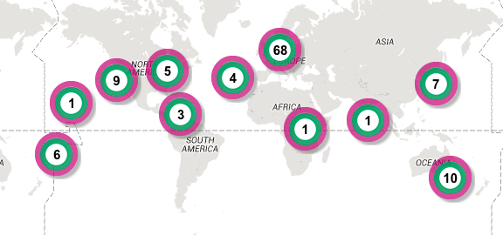
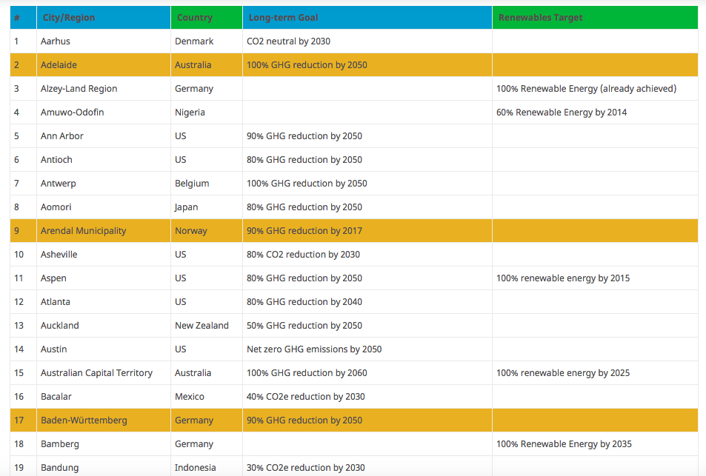
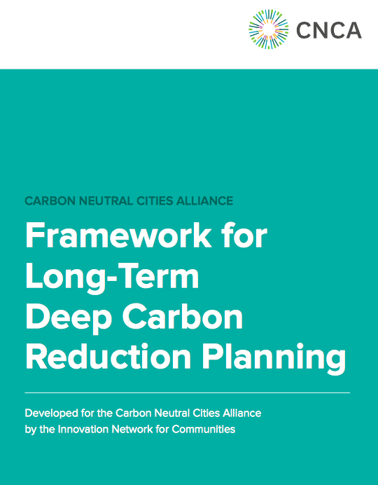
Resources/Tools (cont.)
USDN & CNCA “Innovation Products”
usdn.org
carbonneutralcities.org
CNCA Deep Carbon Reduction Planning Framework & online tool
http://track0.org/cities-regions/
http://www.go100re.net/map/
RE 100

