Slide 1
How can cities get smart(er) and prepare for disruptive technologies: distributed energy, cheap solar, EVs, autonomous vehicles, sharing platforms #REcities
Prof Ray Wills
Managing Director
Future Smart Strategies
Adjunct Professor
The University of Western Australia

Slide 2
How to be a better surfer
What’s happening globally with new tech?
What do markets tell us about how quickly disruptive technologies will impact on everything?
How can emerging hard and soft technologies, apps and social media trends help cities get smart(er), engage, develop, adapt and grow?
Prediction is very difficult, especially about the future. (Niels Bohr)

Slide 3
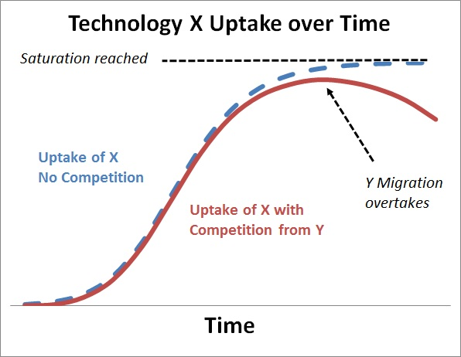
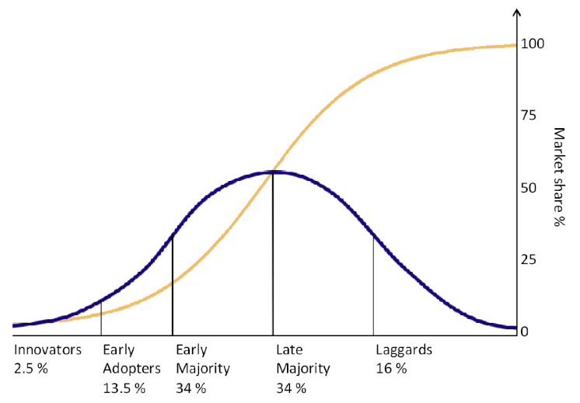
Roger’s diffusion curve (Epidemiology 101)

Slide 4
Technology adoption rates - words

Slide 5
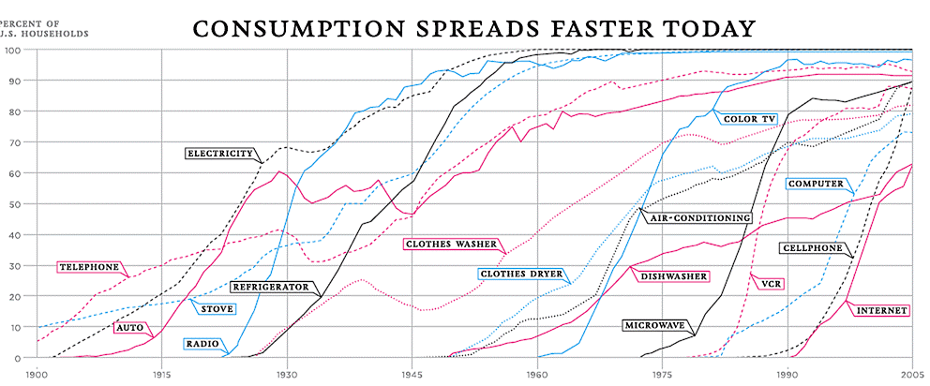
Technology adoption rates – US
Renewables - it’s just technology, stupid.
NY Times
Notes:
http://earlywarn.blogspot.com/2010/06/technology-adoption-in-hard-times.html
Technology diffusion is well understood - we've got countless examples - cars, TVs, BBQs, cell phones, wind turbines, cosmetics, iPods, solar PV, video records, DVD players, LED lights, iPads. And not just things but things within things - like ABS, and fuel injection and airbags in cars - they are all the same, and diffusion rates can be logically and rationally extrapolated. That's how diffusion curves work, and that is the simple model, but not simplistic.
If you fail to extrapolate, you will conclude the future is a long way off. It's not.

Slide 6
Wake up and smell the roses
Buggy whips -> EVs -> ICE -> EVs -> self-driving
(Electric) typewriter -> word processor -> PC
PC -> desktop -> laptop -> tablet
Landline -> mobile -> smartphone (BlackBerry)
Record shops Vinyl -> CD -> (Apple Store)
VHS/Beta -> DVD -> BlueRay -> Cloud
Book Shops Boutique -> mega -> (Amazon)
Retail shop-> Boutique-> chain/mega -> Internet
Energy -> chopping wood -> coal -> wind -> solar

Slide 7
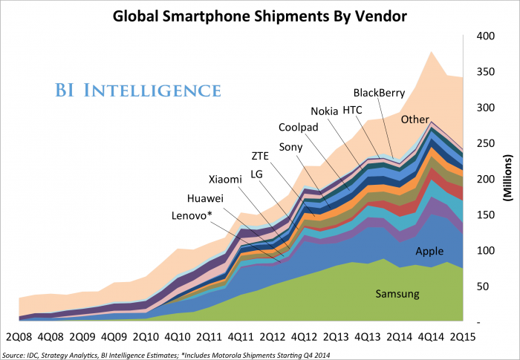
Technology adoption rates – US
Renewables - it’s just technology, stupid.
NY Times
Notes:
http://earlywarn.blogspot.com/2010/06/technology-adoption-in-hard-times.html
Technology diffusion is well understood - we've got countless examples - cars, TVs, BBQs, cell phones, wind turbines, cosmetics, iPods, solar PV, video records, DVD players, LED lights, iPads. And not just things but things within things - like ABS, and fuel injection and airbags in cars - they are all the same, and diffusion rates can be logically and rationally extrapolated. That's how diffusion curves work, and that is the simple model, but not simplistic.
If you fail to extrapolate, you will conclude the future is a long way off. It's not.

Slide 8
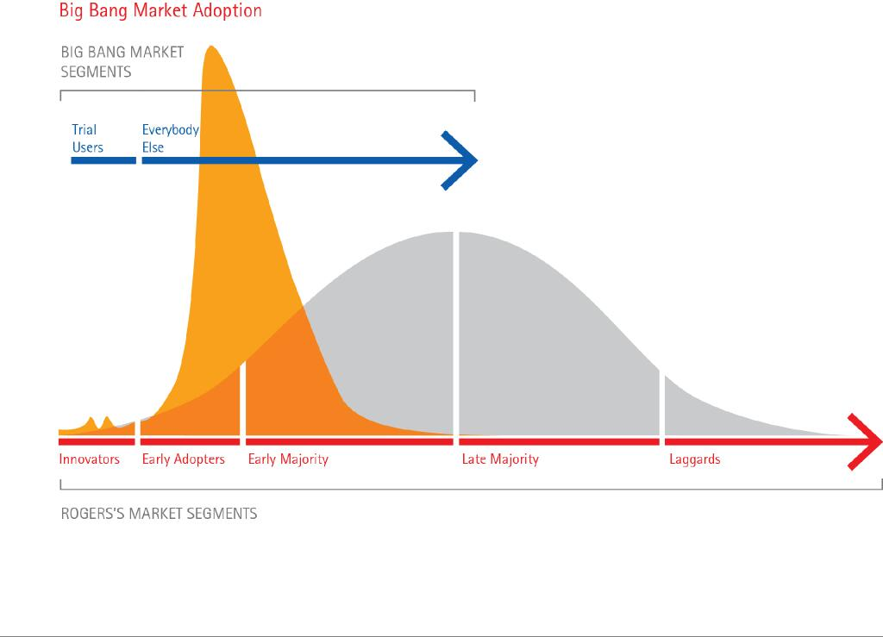
The Big Bang Theory
Notes:
http://www.accenture.com/us-en/Pages/insight-strategy-age-devastating-innovation-big-bang-disruption.aspx

Slide 9
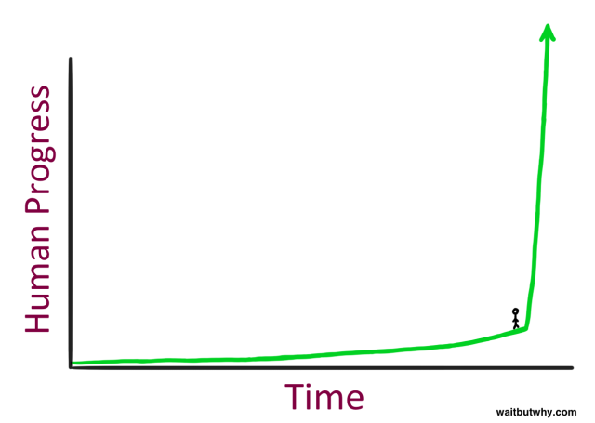
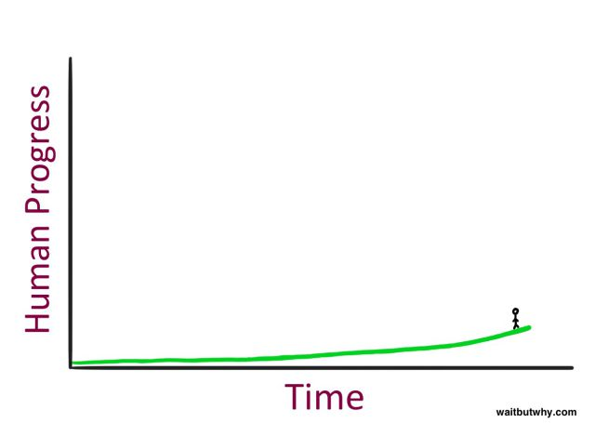
A Brief Moment in Time
Notes:
http://qz.com/514148/what-will-happen-when-we-succeed-in-creating-ai-thats-smarter-than-we-are/

Slide 10
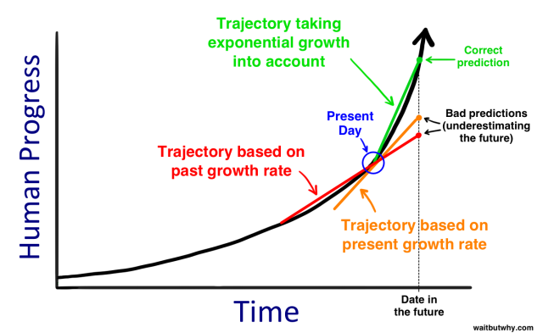
Predicting anything is difficult
Notes:
Ray Kurzweil human history’s Law of Accelerating Returns http://qz.com/514148/what-will-happen-when-we-succeed-in-creating-ai-thats-smarter-than-we-are/

Slide 11
Predicting anything is difficult – really difficult, but …
And don’t forget
the old tech exit
Notes:
Ray Kurzweil human history’s Law of Accelerating Returns http://qz.com/514148/what-will-happen-when-we-succeed-in-creating-ai-thats-smarter-than-we-are/

Slide 12
Understand difference between linear growth and exponential growth …
n = % growth rate, 70/n years;
So
n = 1% doubling time is 70/1 = 70 years
n = 2% doubling time is 70/2 = 35 years
n = 5% doubling time is 70/5 = 14 years
n = 7% doubling time is 70/7 = 10 years
n = 10% doubling time is 70/10 = 7 years
n = 20% doubling time is 70/20 = 3.5 years
n = 30% doubling time is 70/35 = 2 years

Slide 13
Declining cost of PV

Slide 14
Understand difference between linear growth and exponential growth …
n = % growth rate, 70/n years;
So
n = 1% doubling time is 70/1 = 70 years
n = 2% doubling time is 70/2 = 35 years
n = 5% doubling time is 70/5 = 14 years
n = 7% doubling time is 70/7 = 10 years
n = 10% doubling time is 70/10 = 7 years
n = 20% doubling time is 70/20 = 3.5 years
n = 35% doubling time is 70/35 = 2 years
Solar increased 36% pa - 8 fold in 7 years, 2009 to 2016

Slide 15
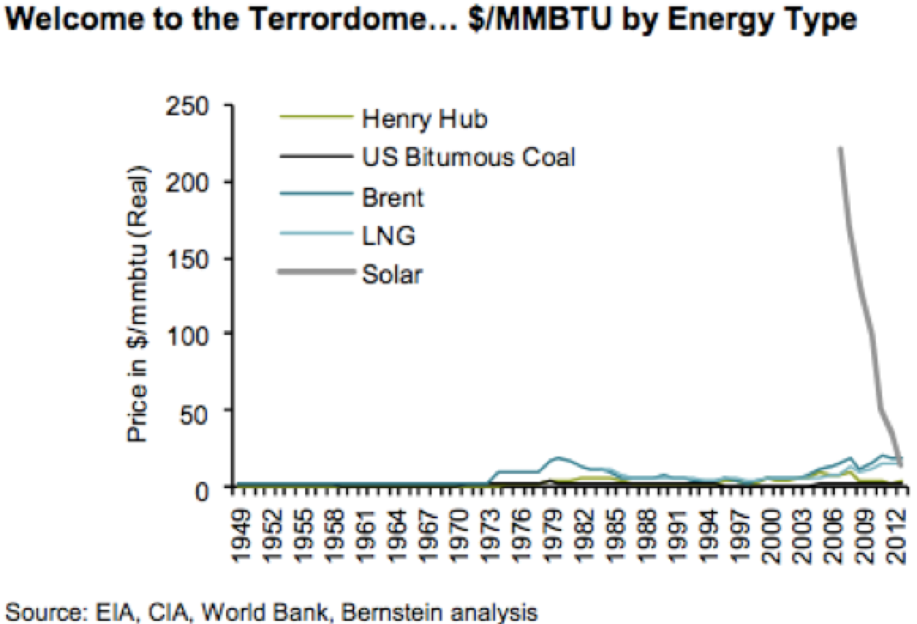
Solar rising – by falling understanding exponential growth

Slide 16
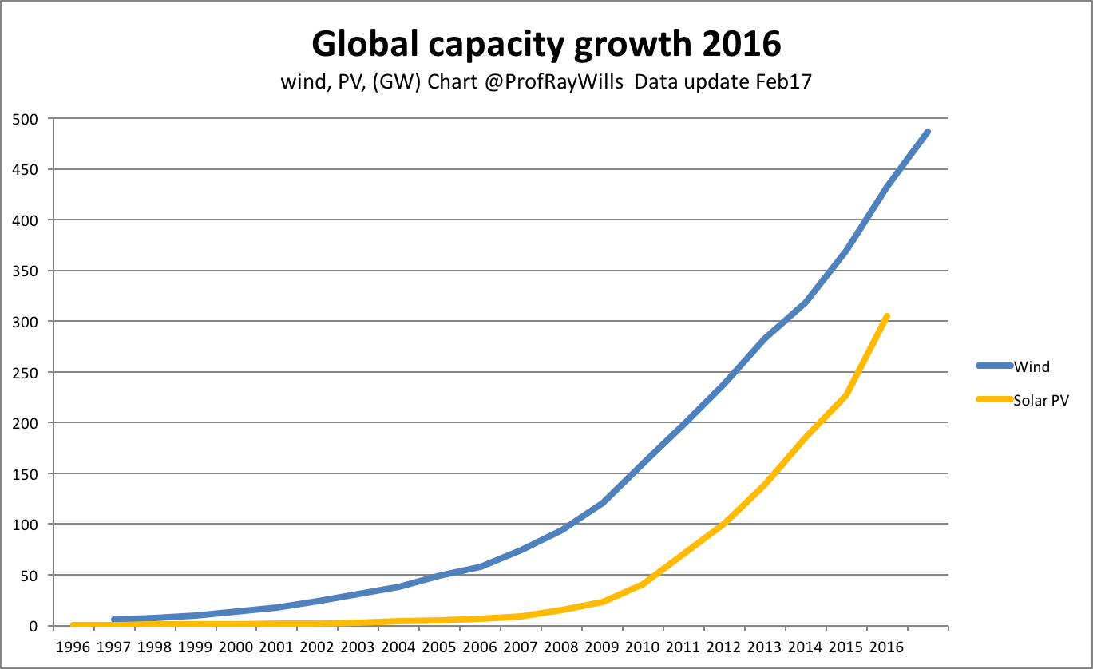
Global renewables growth …
Notes:
The adoption of any technology, the starting point of the first unit isn't relevant, it's when you get the diffusion curve hitting the growth curve. This happened for wind in 2008, the start of my 'renewables clock’ On the same score my 'solar clock' starts 2011, and batteries will be 2019.
The early deployment of any technology – say the first solar in the 1970s - is simply not relevant.
And in fact data on energy use from pre-2008 is of little relevance to 2014 - energy efficiency in particular has changed the game with electricity consumption falling in all developed nations.

Slide 17
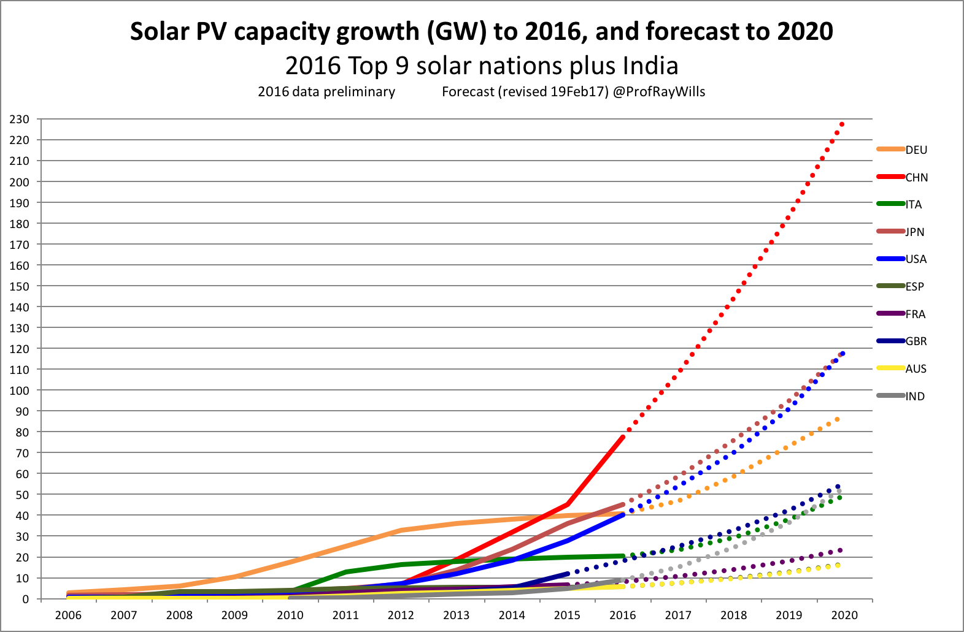
Change in Energy
Notes:
US EIA

Slide 18
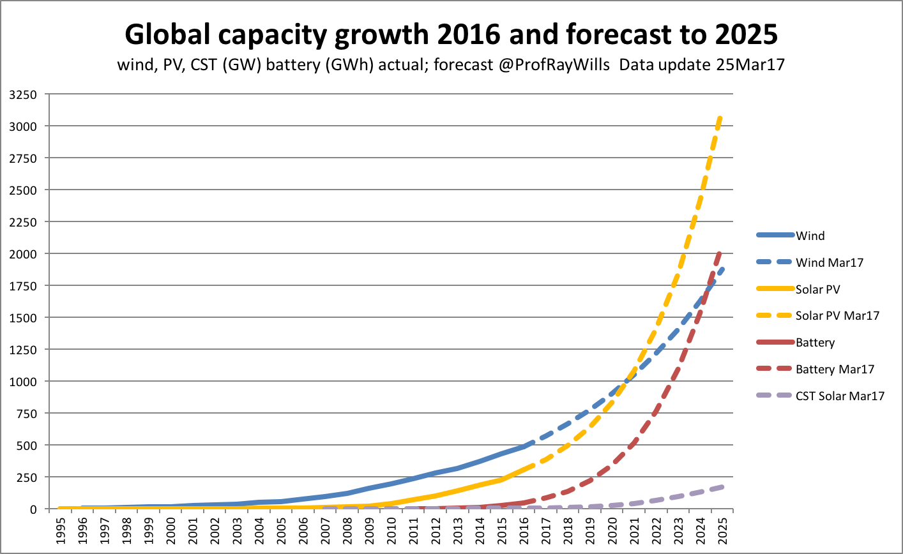
Global renewables growth and forecast
Notes:
The adoption of any technology, the starting point of the first unit isn't relevant, it's when you get the diffusion curve hitting the growth curve. This happened for wind in 2008, the start of my 'renewables clock’ On the same score my 'solar clock' starts 2011, and batteries will be 2019.
The early deployment of any technology – say the first solar in the 1970s - is simply not relevant.
And in fact data on energy use from pre-2008 is of little relevance to 2014 - energy efficiency in particular has changed the game with electricity consumption falling in all developed nations.

Slide 19
Build it more cheaply

Slide 20
Build it more quickly
Notes:
AOTA – all of the above
http://www.dailymail.co.uk/news/article-2735858/3D-printed-spine-used-world-surgery-help-12-year-old-boy-walk-spent-two-months-lying-flat-hospital-bed.html

Slide 21
Employ more people
Notes:
AOTA – all of the above
http://www.dailymail.co.uk/news/article-2735858/3D-printed-spine-used-world-surgery-help-12-year-old-boy-walk-spent-two-months-lying-flat-hospital-bed.html

Slide 22
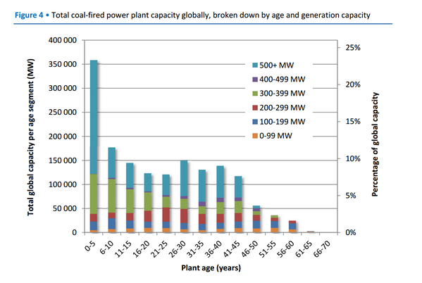
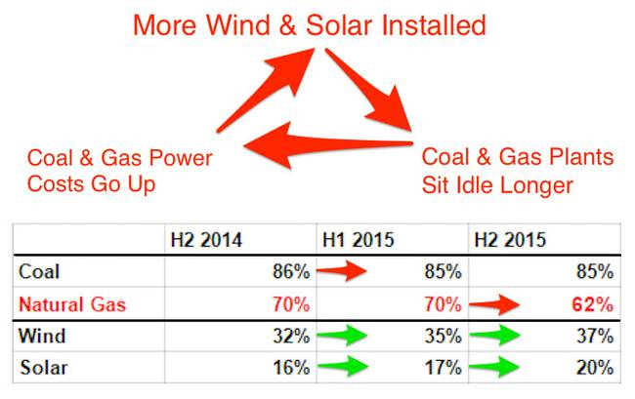
Notes:
Peabody Market Cap: 163.17M

Slide 23
Electricity generation – IEA Total
n = 7% doubling time is 70/7 = 10 years

Slide 24
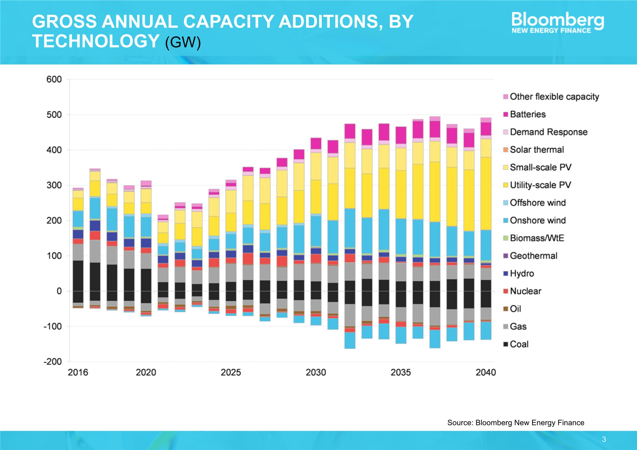
With every entry there is also an exit …
Notes:
http://www.netl.doe.gov/coal/refshelf/ncp.pdf

Slide 25
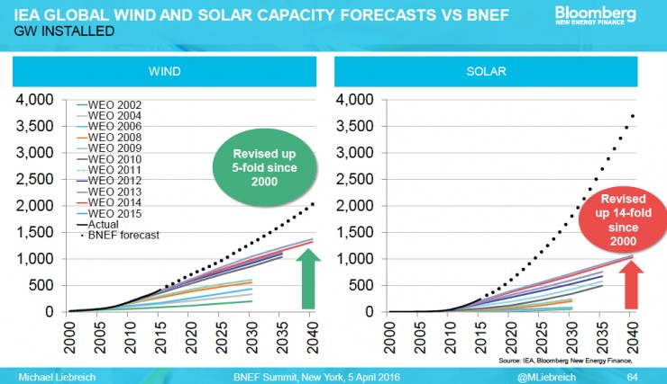
Forecasts not based on experience
Assuming linear growth
(or less) is poor science
and poorly informs
policy decisions and
planning outcomes

Slide 26
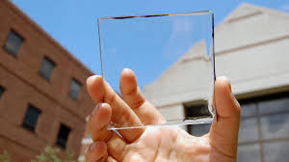
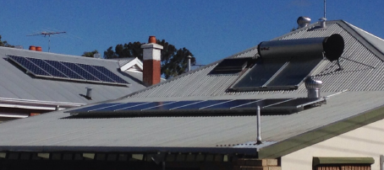
Solar gen 1 (gen 2, gen 3, … )
1st gen solar cell made from silicon 2nd gen solar cell thin-films
1st gen solar panels ‘fixed-on’ 2nd gen emerging – building material: < cost labour, material
3rd gen solar cell – may be nanotubes, silicon wires, organic dyes, and conductive plastics – lead to solar inks for printing, solar paint on any surface, personal wearables.
Notes:
Solar tech still early generation – what will gen 5 look like??
http://www.solar-facts-and-advice.com/solar-cells.html

Slide 27
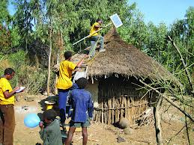
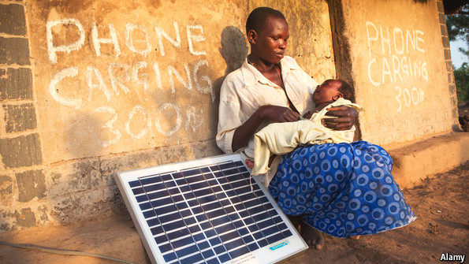
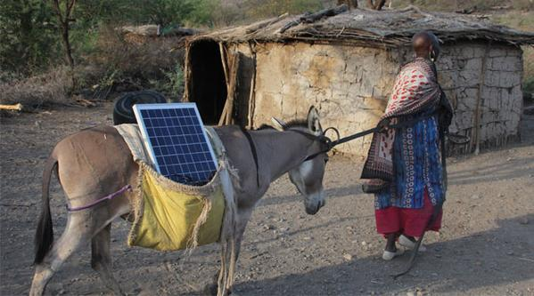
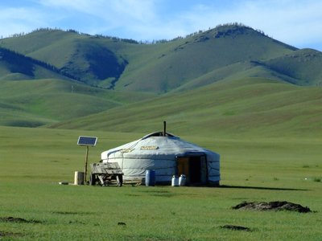
Individuals can act in different ways …

Slide 28
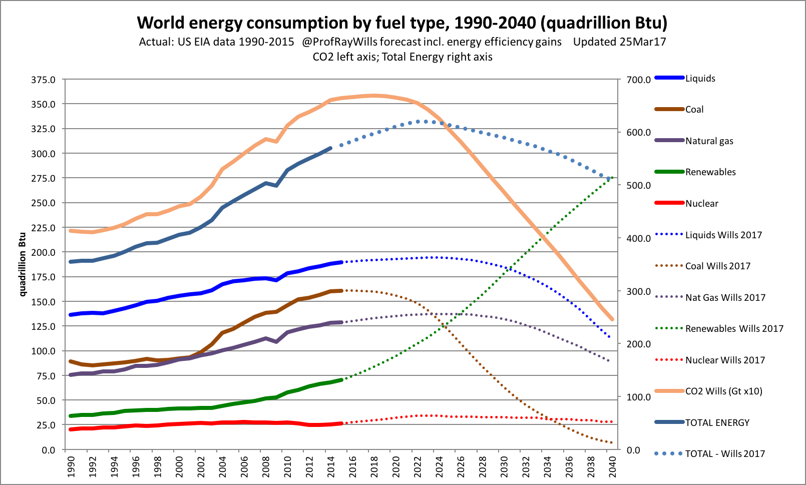
Change in Energy
Notes:
US EIA

Slide 29
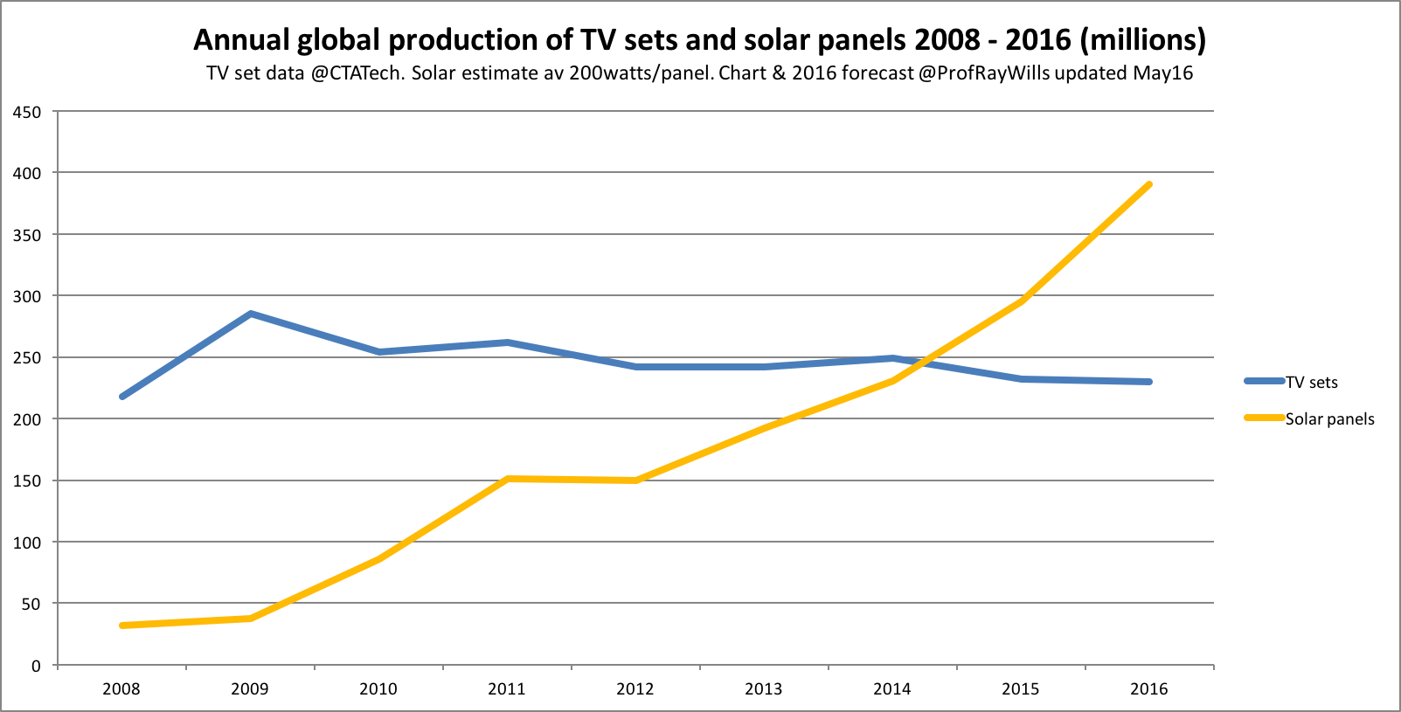
Solar as just another consumer product

Slide 30
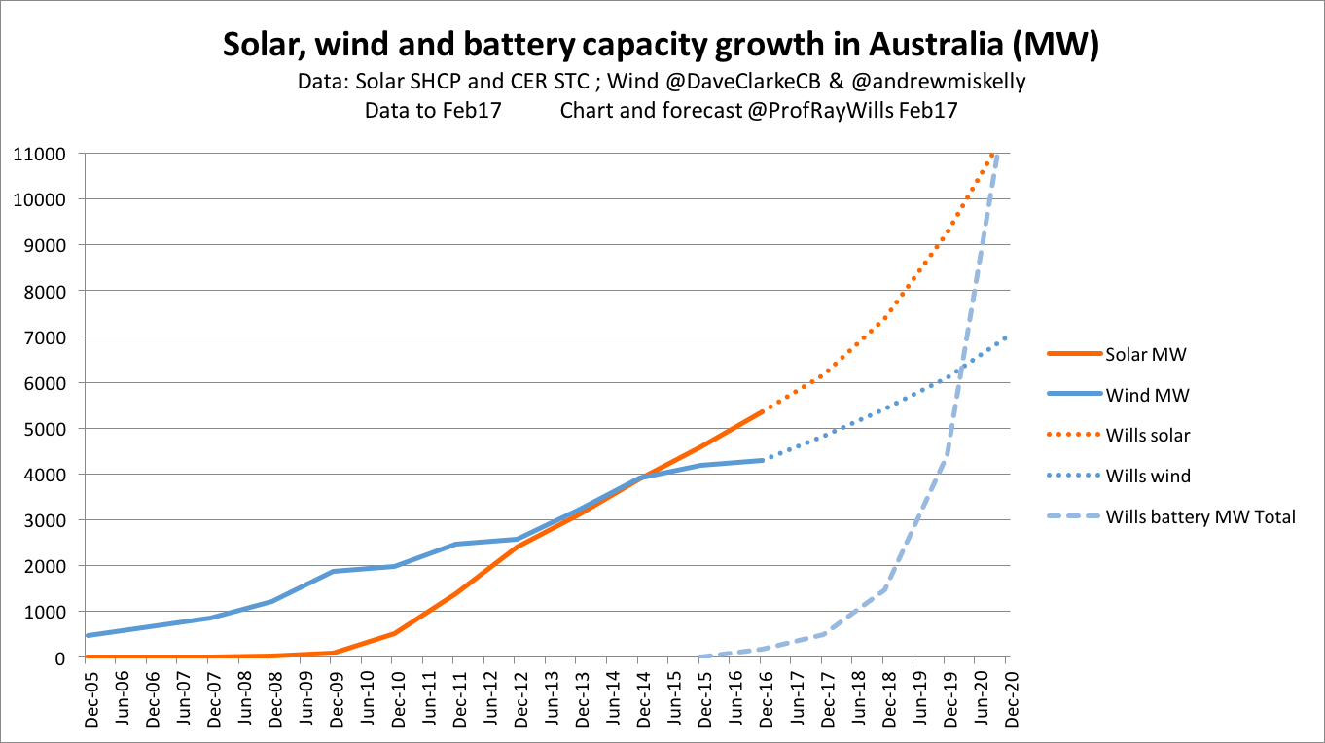
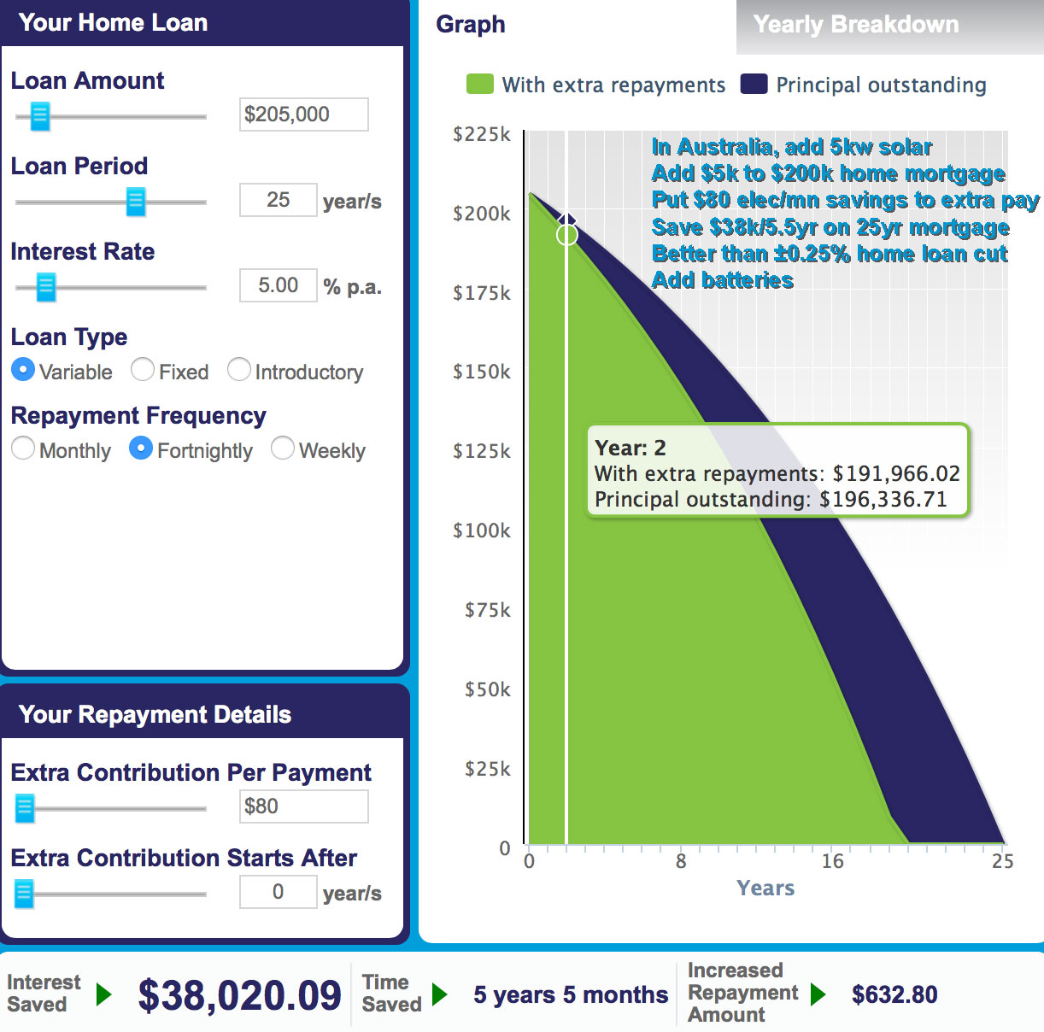
Self generation as just another consumer product

Slide 31
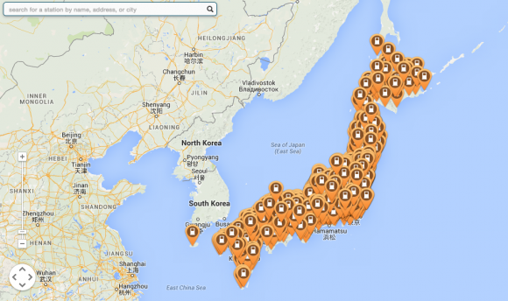
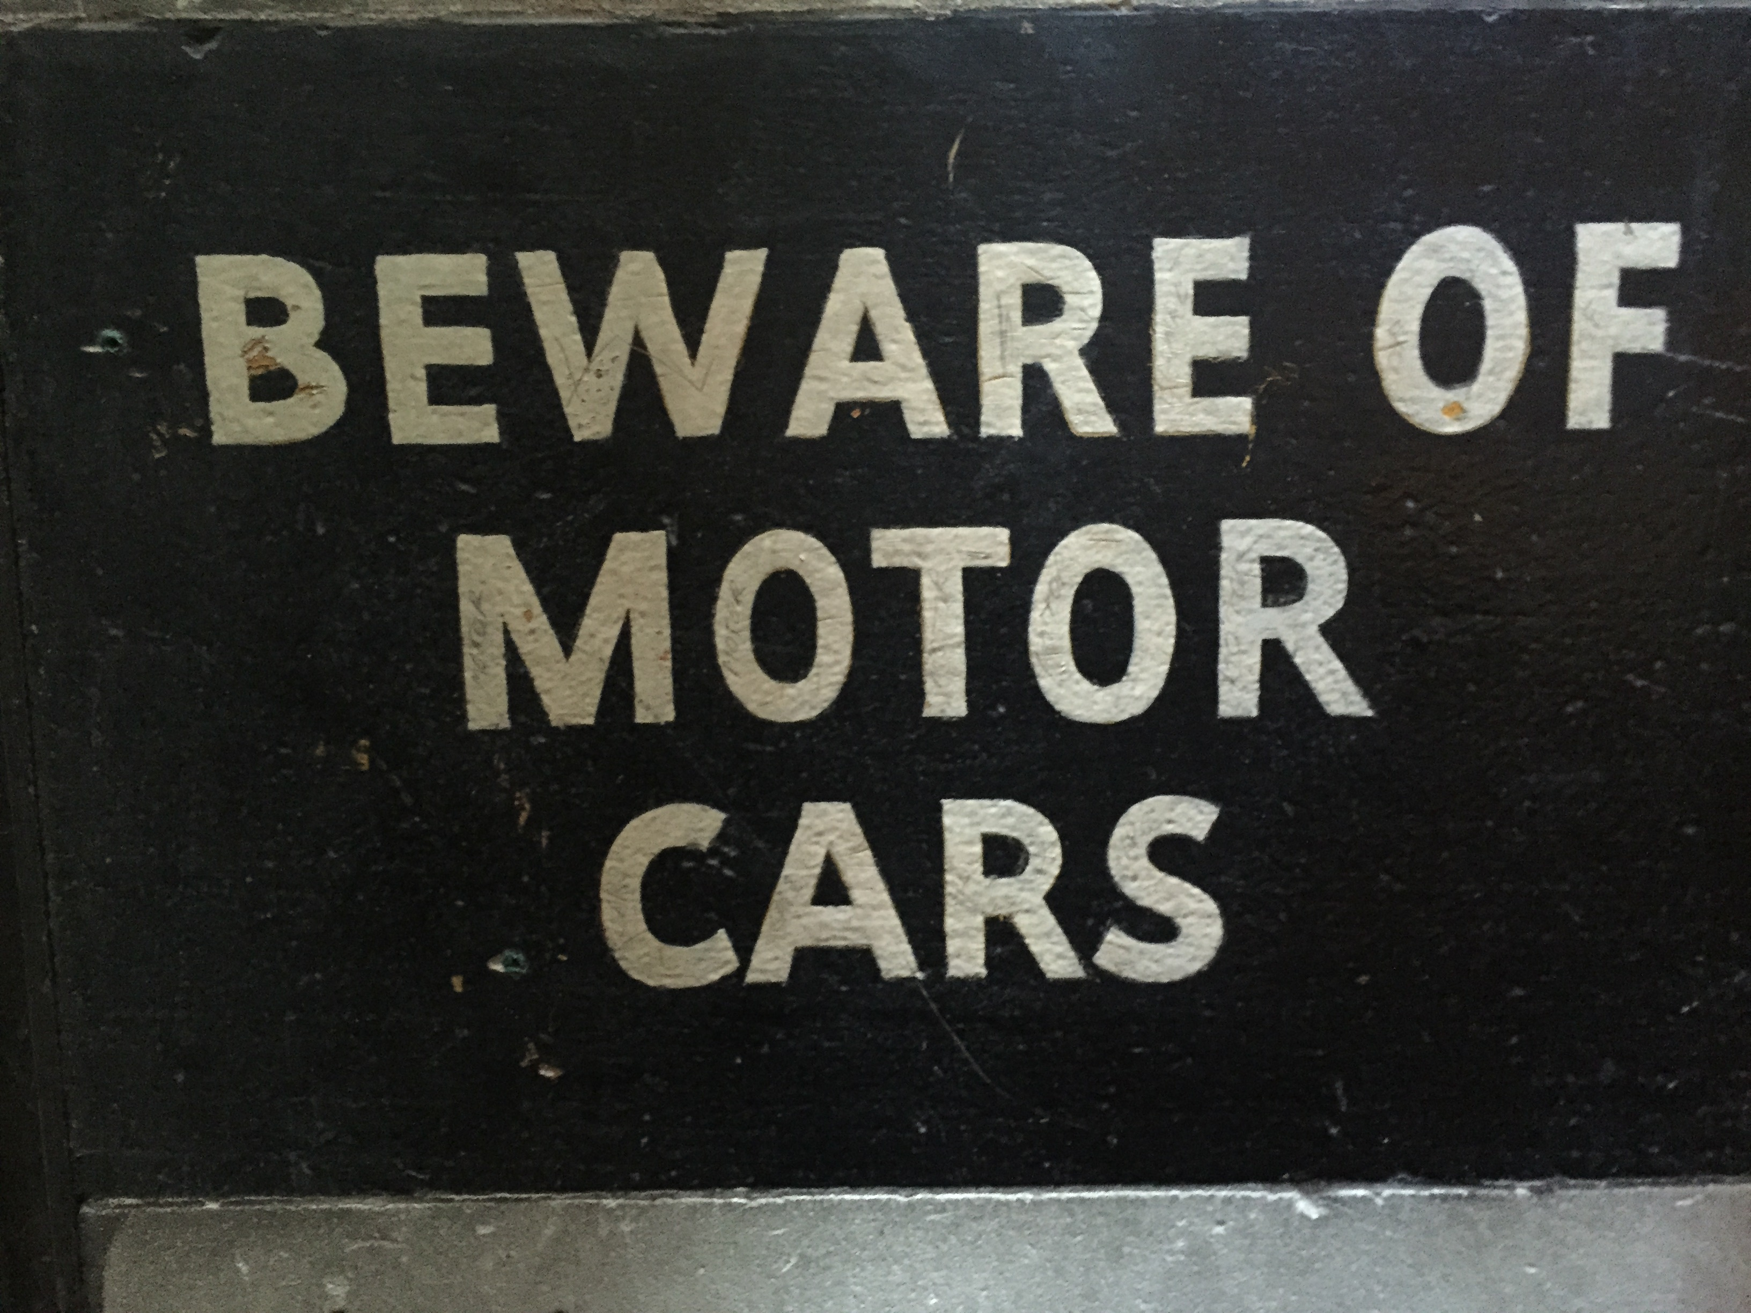
Batteries – home storage + EVs

Slide 32
A swarm, a cluster, a wave, a tsunami
20th Century: Command and Control 21st Century: Suggest & Choose – local, distributed, democratic – open source, exponential innovation
Renewable energy, EVs, batteries
eRetail and market-led marketing
iEverything – Internet of Things (IoT) + sensors
Automation, hybrids, AI & CI, robotics, robility
3D printing, additive manufacturing, construction
Finance, banking, insurance – and crowd-funding
Suggest & Choose driving supply chain from bottom
Notes:
AOTA – all of the above
http://www.dailymail.co.uk/news/article-2735858/3D-printed-spine-used-world-surgery-help-12-year-old-boy-walk-spent-two-months-lying-flat-hospital-bed.html

Slide 33
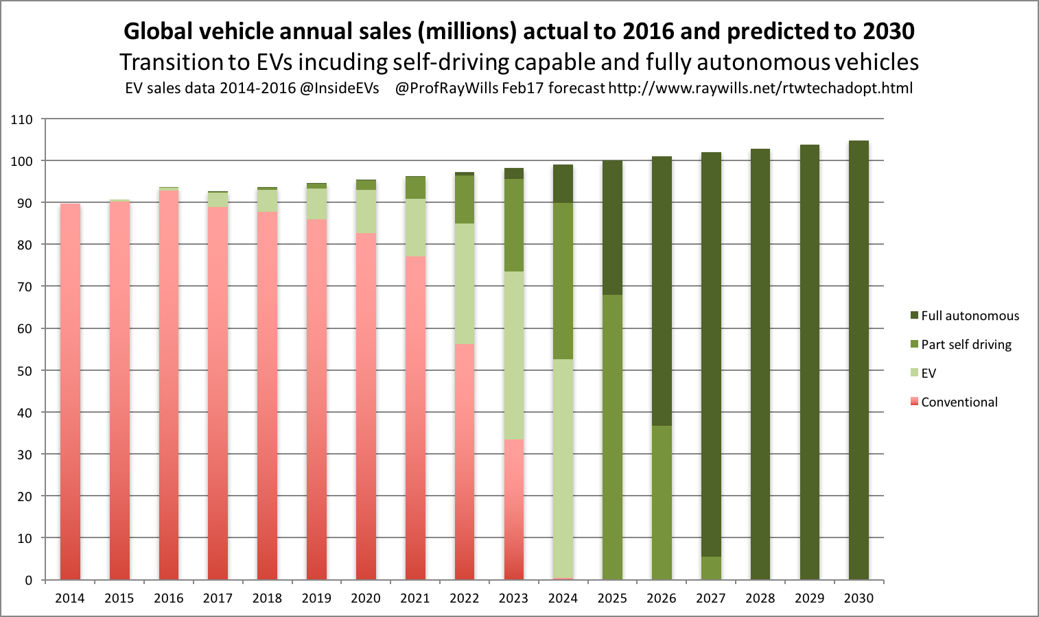
Potential EV growth
Notes:
http://www.iea.org/papers/2011/Renew_Policies.pdf

Slide 34
Cities also drive change
Notes:
In an environment with an extremely low barrier to entry (anonymity) , there's little incentive to protect or otherwise maintain a reputation

Slide 35
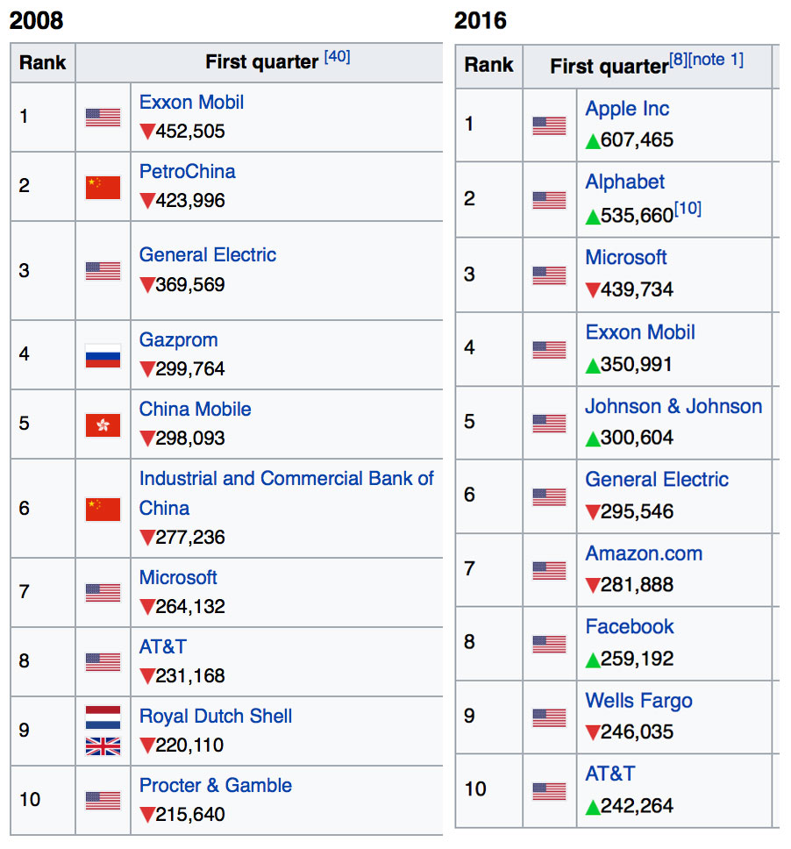
Businesses can act …
Notes:
/

Slide 36
Groups can act …

Slide 37
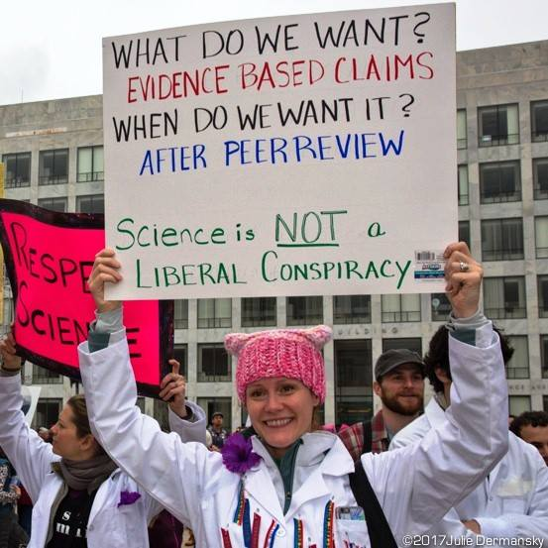
Individuals can act …

Slide 38
World’s largest …
taxi company owns no taxis (Uber)
hotel chain owns no property (AirBnB)
telcos own no wires (Skype, WeChat)
retailers own no stock (Ebay, Alibaba)
financial houses that hold no currency (PayPal)
media service creates no content (Facebook)
movie house owns no cinemas (Netflix)
software vendors don’t write apps (Apple, Google)
Will largest energy companies not generate electricity?
What other businesses will go virtual? (Can everything?)
Battlefield is slickest customer interface + experience
Notes:
https://techcrunch.com/2015/03/03/in-the-age-of-disintermediation-the-battle-is-all-for-the-customer-interface/

Slide 39
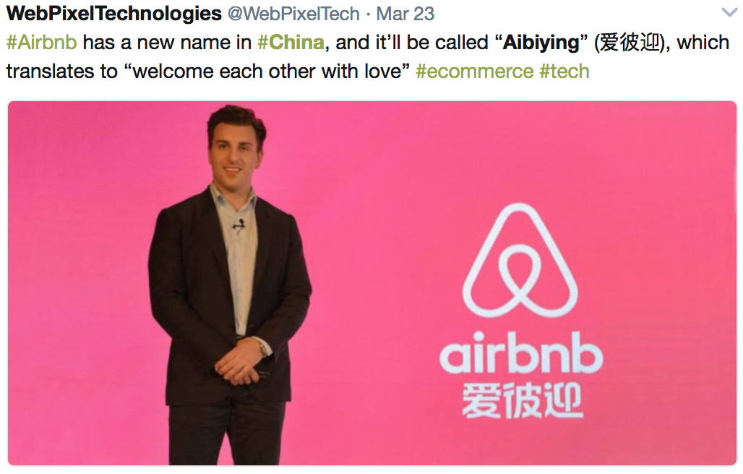
World’s largest …
taxi company owns no taxis (Uber)
hotel chain owns no property (AirBnB)
telcos own no wires (Skype, WeChat)
retailers own no stock (Ebay, Alibaba)
financial houses that hold no currency (PayPal)
media service creates no content (Facebook)
movie house owns no cinemas (Netflix)
software vendors don’t write apps (Apple, Google)
Will largest CSR companies do no CSR?
What other businesses will go virtual? (Can everything?)
Battlefield is slickest customer interface + experience
Notes:
https://techcrunch.com/2015/03/03/in-the-age-of-disintermediation-the-battle-is-all-for-the-customer-interface/

Slide 40
Global technology growth and forecast
New technology iterating faster - rapid, exponential (non-linear) growth.
Planners in traditional technology seem unprepared for change, not based on observations in past perturbations in energy markets.
Rapid emergence + convergence of complementary technologies: energy storage, electrification of transport, self-driving vehicles, robotics, AI – and integrated in the emergence of ‘smart cities’ – all delivering additionality to momentum for change.
Sophistication of developing energy control systems changing paradigm of what is possible in 21stC
What once made a company valuable has changed dramatically
Diversity!! Multiple agents of change, not just government, but also business, consumer, and community drivers add much political pressure especially through social media channels.

Slide 41
Final advice
Don’t be afraid
In particular, don’t be afraid of being ambitious
The future is already here – it's just not evenly distributed. William Gibson

Slide 42
Future Smart Team

