Slide 1
Global 100% RE Cities & Regions Network
Michael Dean, Climate and Energy Project Coordinator, ICLEI Canada
Renewable Cities Forum, Vancouver, 18 May 2017
Notes:
An activity brought to you in the context of the 100% Renewable Energy Cities and Regions Network, ICLEI’s thematic community on renewable energy transition and a contribution to the multistakeholder Global 100%RE Campaign

Slide 2
Global 100% RE Cities and Regions Network
Cities, towns and regions with:
a 100% RE target in at least one sector or commitment to explore the 100% RE pathway
interest in international cooperation
Platform for knowledge exchange and policy dialogue with other leading cities
inclusive, global
free of charge
Notes:
An activity brought to you in the context of the 100% Renewable Energy Cities and Regions Network, ICLEI’s thematic community on renewable energy transition and a contribution to the multistakeholder Global 100%RE Campaign

Slide 3
Benefits of engaging
Learning and cooperation opportunities with other leading cities
Thematic guidance and workshops
Access to experts on renewable energy and energy efficiency
Globally promote local solutions and service providers
Worldwide recognition of the progress achieved locally
Visibility to champion local and regional leaders on a global level
Notes:
Learning and cooperation opportunities with other leading cities
Thematic guidance and workshops
Access to experts on renewable energy and energy efficiency
Opportunity to globally promote local solutions and service providers
Worldwide recognition of the progress achieved locally
Visibility to champion local and regional leaders on global level

Slide 4
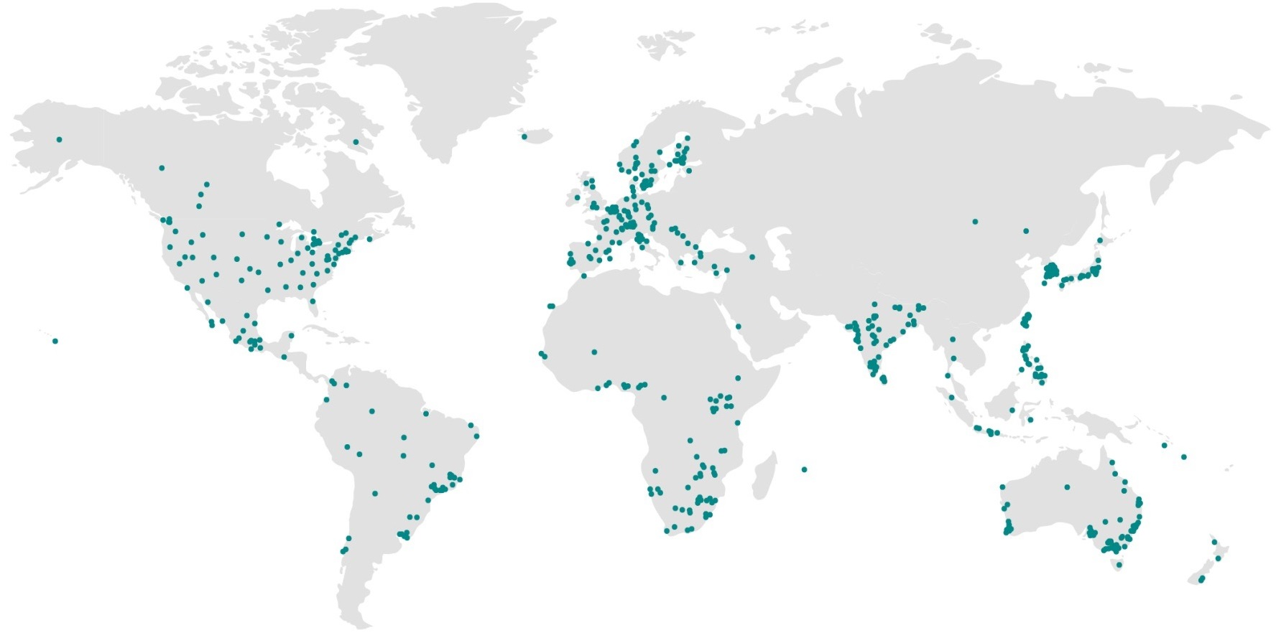
Meet some of the Cities in the 100%RE Cities and Regions Network
Växjö
100%RE by 2030
Inje County
100%RE electricity by 2045
Vancouver
100%RE
before 2050
Saanich
Learning city
Malmö
100%RE by 2030
Jeju Province
100%RE
by 2030
Aspen
100%RE electricity
by 2015
Pingtung County
Learning city
Byron Shire
100%RE
by 2025
Tshwane
Learning city
Australian Capital Territory
100%RE electricity
by 2020
11 Cities are formally participating
45+ engaged in activities offered
Notes:
Local governments are demonstrating that it is possible to achieve such targets such as the City of Aspen that is now distributing 100%RE electricity through its municipal utility.
The reasons that motivate cities to make such ambitious targets usually include health benefits, energy security and accessibility, socio-economic development and climate change mitigation and resilience. The local government representatives here with us today will surely share more details on this.
11 Cities are formally participating = have submitted signed application form and recieved confirmation letter
Yet, challenges remain: policy, governance, technology, financial, market organization, local capacities, etc.
What support is available?

Slide 5
Thank you!
More information on:
www.iclei.org/lowcarboncity/100RE
http://carbonn.org/

