Slide 1
Edmonton’s Community Energy Transition Strategy
Blatchford Energy System
Renewable Cities - Global Learning Forum 2017
Creating an Ecosystem That Fosters Innovation: Looking at the City of Edmonton from MaRS

Slide 2
Overview
The Context:
Edmonton’s Energy Transition
The Project:
Blatchford
Notes:
Context is everything …
Blatchford is an important showcase
Blatchford will be 3%

Slide 3
Energy Transition History
A risk management strategy to make Edmonton an energy sustainable city
Approved April, 2015
Entrenched in City Policy C585
Notes:
Edmonton’s Community Energy Transition Strategy is … a risk management strategy designed to:
Reduce Edmonton’s GHG emissions
Reduce Edmonton’s dependence of fossil fuels
Increase energy efficiency in all sectors
Position Edmonton for economic opportunities as the world transitions to clean energy
Council approved the strategy in April 2015 … and went on to entrench it in a new City Policy C585.
C585 describes an energy sustainable Edmonton with … energy literate citizens … energy conserving lifestyles … world-class energy efficiency in all types of buildings … strong shifts to active and public transportation … an urban form designed to avoid unnecessary energy use … a greener power grid … electricity that’s produced close to where it’s used … and increased electrification of Edmonton’s transportation system.

Slide 4
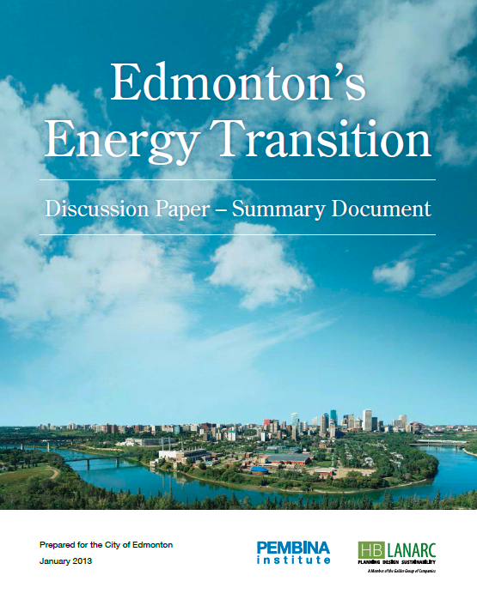
ET - how we got here …
What is sustainability? | What is possible? | What is supported? | What is justified
Notes:
You’ll also recall, we went through a number of steps to arrive at the strategy.
It began with The Way We Green … which identified energy and climate change as Edmonton’s greatest environmental challenges.
This led to more in-depth studies that showed it was possible to significantly reduce Edmonton’s energy use and GHG emissions … and that most of these opportunities were cost effective.
These possibilities were then explored by a Citizens’ Panel of average Edmontonians who recommended … that the City of Edmonton take measures to become a low carbon city by 2050.
The energy transition strategy resulting from this, contained an 8-year action plan with more than 150 tactics.

Slide 5
ET Implementation
Phase 1 2015 - 2016 | Phase 2 2015 - 2018 | Phase 3 2019 – 2022 (and beyond)
Establishing Governance / Management Frameworks | Engage Edmontonians Launch small-scale pilot programs Leading by Example | Scale-up to Community-size programs
Notes:
The strategy is being implemented in three phases.
Phase 1 was a foundational phase … making sure we had the necessary governance and management structures in place to support Edmonton’s multi-decade, energy transition journey. Phase 1 involved … establishing a supporting City Policy … obtaining additional operating funding … creating a new City Council Advisory Committee (to oversee the strategy’s implementation and provide advice to Council) … establishing a related Council Initiative … and establishing meaningful corporate measures and outcomes.
Phase 1 was completed in 2016 … setting the stage for Phase 2 which is currently underway and runs to 2019.
Phase 2 is about engaging a million Edmontonians to understand the risks of climate change and take action. It’s about piloting relatively small initiatives that will grow to become large scale community programs (in Phase 3). It’s about the City of Edmonton leading by example in its own operations as a catalyst for community action. And it’s about aligning our dollars and our efforts with other orders of government.

Slide 6
Phase 2
Projects/initiatives: Engage Edmontonians Buildings Clean electricity Local industry Land-use / transportation City leads by example
Notes:
Phase 2 projects can be grouped into six general categories … projects that engage Edmontonians
… projects that advance wise energy use in buildings
… projects that advance clean electricity generation
… projects that advance wise energy use in local industry
… projects that advance energy efficient land-use and transportation
… and projects in which the City leads by example in its own operations.
I won’t go into all the projects discussed in the Annual Report. But, I’ll touch on a few that will be receiving community attention in coming months.

Slide 7
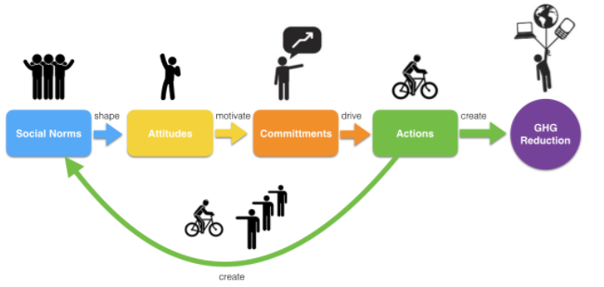
Engaging Edmontonians
Edmonton’s ET Marketing & Communications Strategy
Notes:
Under the heading “Engaging Edmontonians”, there’s a variety of work underway with none more important that the development of Edmonton’s Energy Transition Marketing and Communication Strategy. As I mentioned, engaging a million Edmontonians is an important goal in Phase 2. Fortunately, we’re starting from a good place. 60% of Edmontonians surveyed say they are either alarmed or concerned about climate change and want to see action.
So far we’ve completed marketing research and formulated a core strategy. In May and June we’ll be designing and producing the creative materials that will incorporate the City’s messages. A staged launch will happen in late 2017, reaching full speed in early 2018.

Slide 8
Energy Use in Buildings
EnerGuide Assessment and Labelling Program for Residential Buildings Large Building Energy Reporting and Disclosure Program
Notes:
Under the heading … advancing wise energy use in buildings … two important pilot projects will be launched this June.
First is an energy labelling program for Residential Buildings. On a voluntary basis, this project will encourage owners of new and existing homes to conduct EnerGuide Audits. The energy performance of these homes will be summarized on an energy label that will be available to both the homeowner, prospective buyers and the public on an on-line platform. Overall, the audit will assist homeowners to identify energy efficiency improvement opportunities. Moreover, the label will help buyers to attribute value to energy efficiency.
A second pilot project will be launched in June 2017 that’s aimed at wise energy use in large buildings. Under this program, large building owners will voluntarily report, benchmark and publicly disclose the energy performance of their buildings. Again, this information will help inform building owners and tenants about energy efficiency improvement opportunities … and help to attributed value to energy efficiency.
Both of these pilot projects are in the detailed design stage and have undergone extensive stakeholder engagement. As part of both pilot projects, the City will be following a market transformation approach that will include a combination of marketing, education, capacity building and incentives

Slide 9
Transportation
Edmonton’s Electric Vehicle Strategy
Notes:
Another project I want to mention is the Establishment of Edmonton’s Electric Vehicle Strategy which will be presented to Council Committee in July. The research and extensive stakeholder engagement for that strategy is largely complete. The strategy will explain the GHG reduction opportunity from EVs. It will also outline the need for City leadership if we are to accelerate the purchase of electric vehicles in Edmonton.

Slide 10
City Leads By Example
Update of the Sustainable Building Policy C532 LRT expansion Electric buses Blatchford
Notes:
Of course, it the City is going to be successful in leading the community, we first need to lead-by-example in our own operations. The annual report identifies a number of initiatives where we’re doing just that. One, of particular note, is the update of the City’s Sustainable Building Policy that we’ll be presenting Item 6.8.

Slide 11
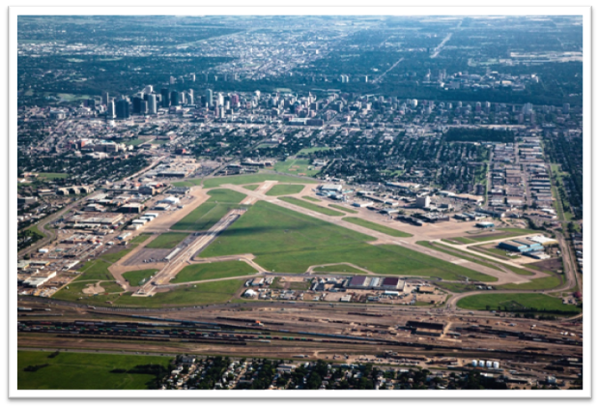
Once in a lifetime opportunity
Blatchford will be home to 30,000 residents all living sustainably together on 536 acres in the heart of the city.
Blatchford is a once-in-a-lifetime city building opportunity. The project is about developing a community with intentionally different outcomes.

Slide 12
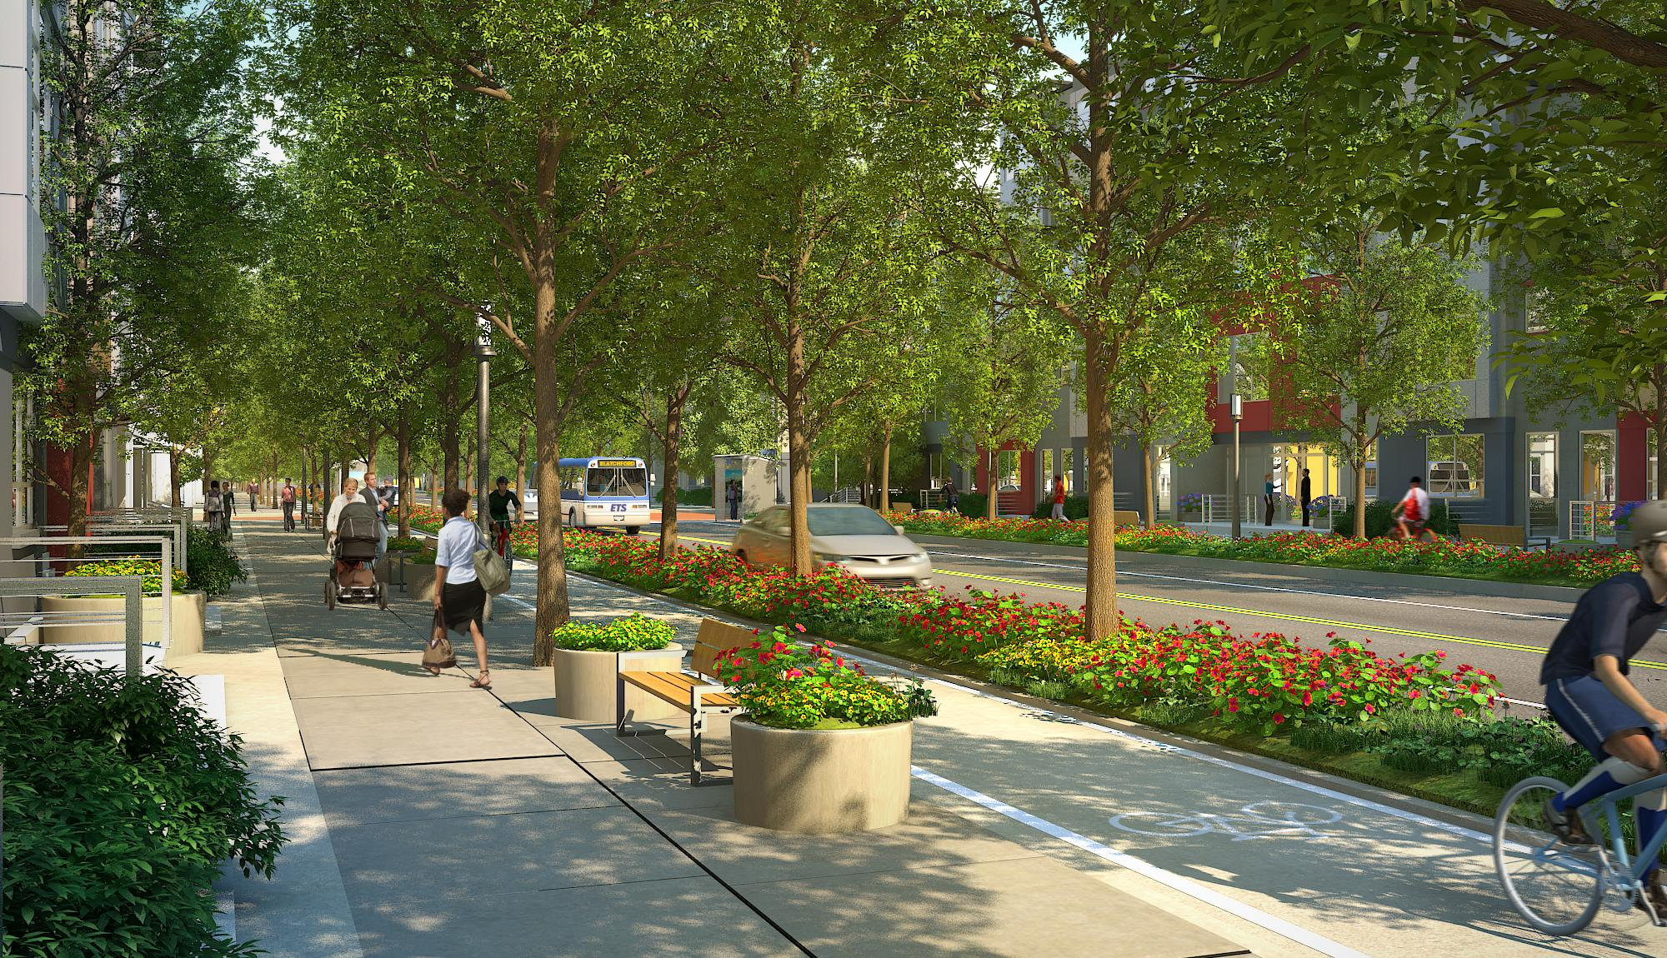
Vision
Blatchford will be home to up to 30,000 Edmontonians living, working and learning in a sustainable community that uses 100 percent renewable energy, is carbon neutral, significantly reduces its ecological footprint, and empowers residents to pursue a range of sustainable lifestyle choices.

Slide 13
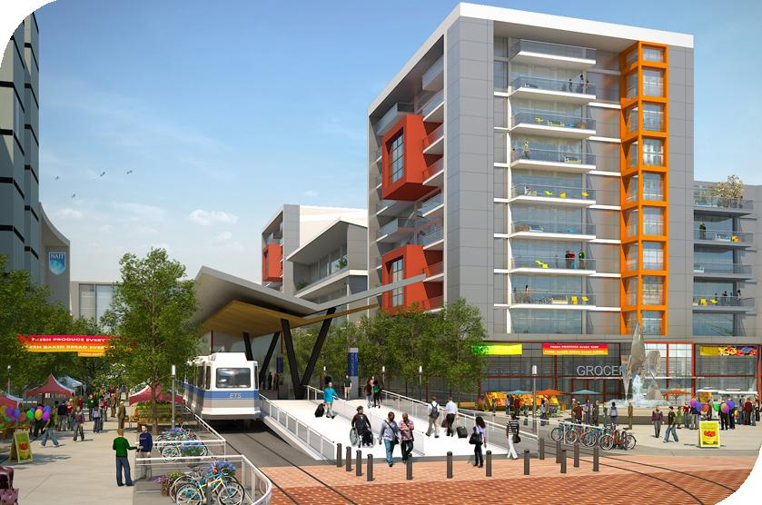
Transit-oriented development
Maximize access to public transportation and incorporate features to encourage use of public transit over private automobile
Use of transit within the community will be comfortable and attractive to a range of users in all seasons
Notes:
Blatchford will:
• Maximize access to public transport and incorporates features to encourage use of public transit over private automobile.
• Be a unique opportunity for development of the Town Centre to coincide with the construction of the LRT.
• Be designed so the use of transit within the community will be comfortable and attractive to a range of users in all seasons and will prioritize transit over automobile use.

Slide 14
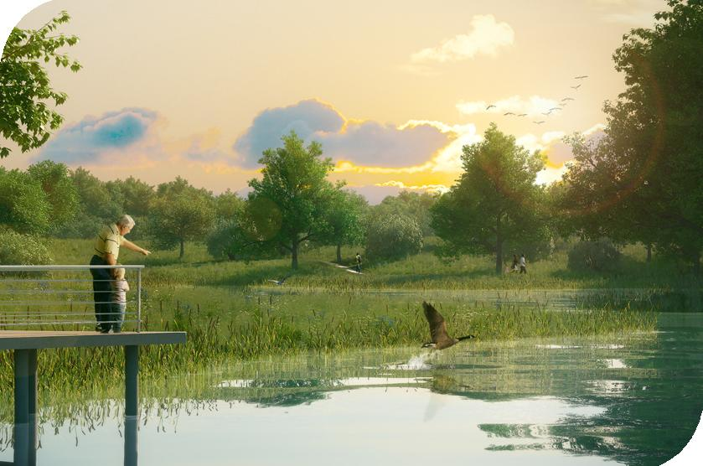
Parks and green spaces
Maximize park and open spaces (18% of development)
Diversity of park spaces for use in all seasons
Community gardens and fruit orchards
Notes:
Blatchford will have:
• 18% of development allocated to parks and green spaces (vs. 8-10% in a standard community).
• A diversity of park spaces including a large central park and a range of smaller, linear park spaces.
• Low Impact Development (LID) features including:
Bioswales, rain gardens
Green roofs
Naturalized wetlands on west side of the stormwater pond to filter pollutants
Customized natural landscaping
Rainwater cisterns to store and reuse roof runoff.
Green space that will be fully integrated into the community and represent a network of high-quality green spaces with opportunities for food production, for example
• Community gardens
• Fruit orchards

Slide 15
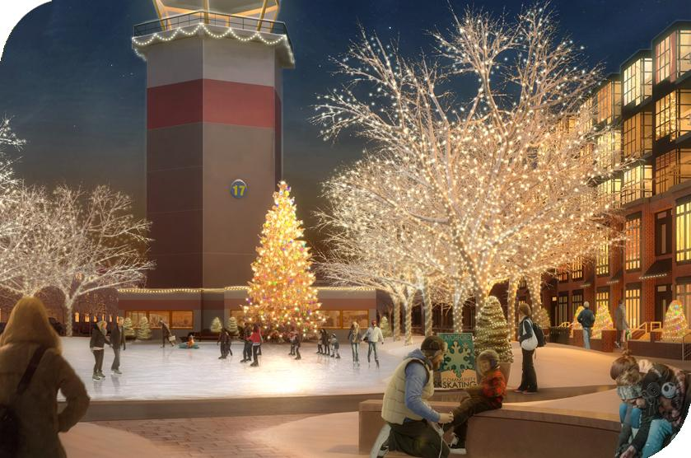
Liveability
Create public spaces that promote people’s happiness and wellbeing (placemaking)
Gathering spots designed to foster community
Programmed and non-programmed spaces
Notes:
Blatchford will have:
• An urban design framework that creates a strong sense of place that is coherent and vibrant.
• Gathering spots carefully designed to foster community.
• Programmed and non-programmed spaces for people to connect.
• An education program that will encourage Blatchford residents to become living examples and ambassadors for sustainable lifestyles, promoting these ideals to other Edmontonians, and building pride in our city. (Community of shared interest).

Slide 16
Conservation
High Performance Buildings
Efficiency
District Energy Sharing System
Renewables
Geo-exchange Sewer Heat Exchange
Solar PV
Notes:
-

Slide 17
Conservation
High Performance Buildings
Efficiency
District Energy Sharing System
Renewables
Geo-exchange Sewer Heat Exchange
Solar PV

Slide 18
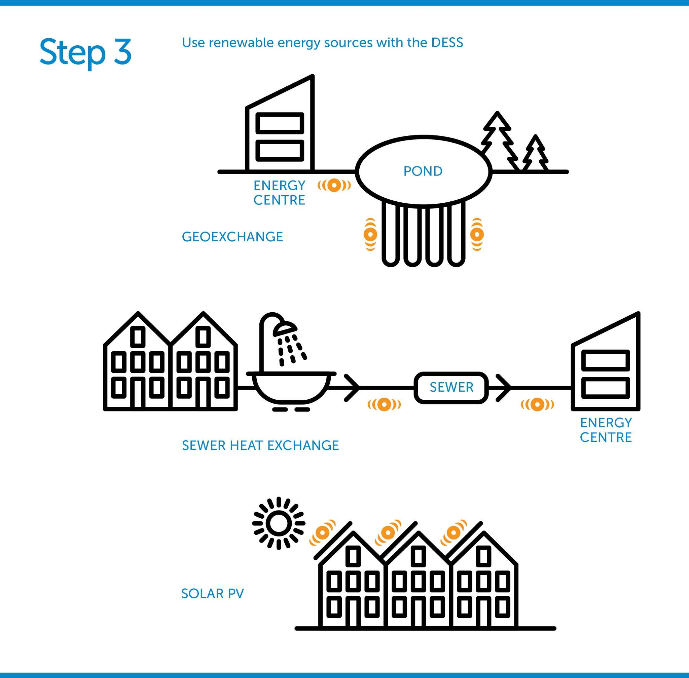
Conservation
High Performance Buildings
Efficiency
District Energy Sharing System
Renewables
Geo-exchange Sewer Heat Exchange
Solar PV
Notes:
53% of energy from Geoexhange
47% other loads from green electricity – e.g. Solar PV, wind
Regulatory challenges – provincial regulations do not currently allow for renewable over site boudaries

Slide 19
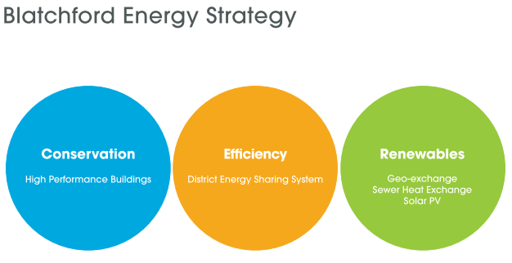
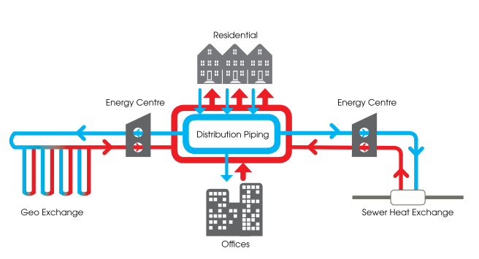

Slide 20
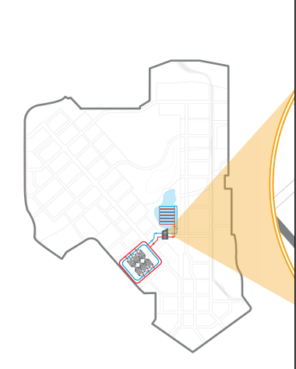
Geoexchange Field Under Pond
Distribution Piping System to TH’s
Energy Centre #1
Notes:
This is a schematic of how the geo-exchange will look for stage one

Slide 21
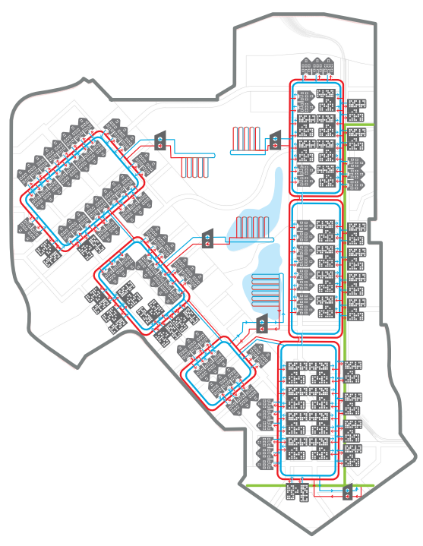
Notes:
At full buildout here is how the geo-exchange is expected to look … from a schematic perspective
The project will however look a the ‘state of the technology’ at each stage to determine the most effective approach to achieving the carbon neutral vision

Slide 22
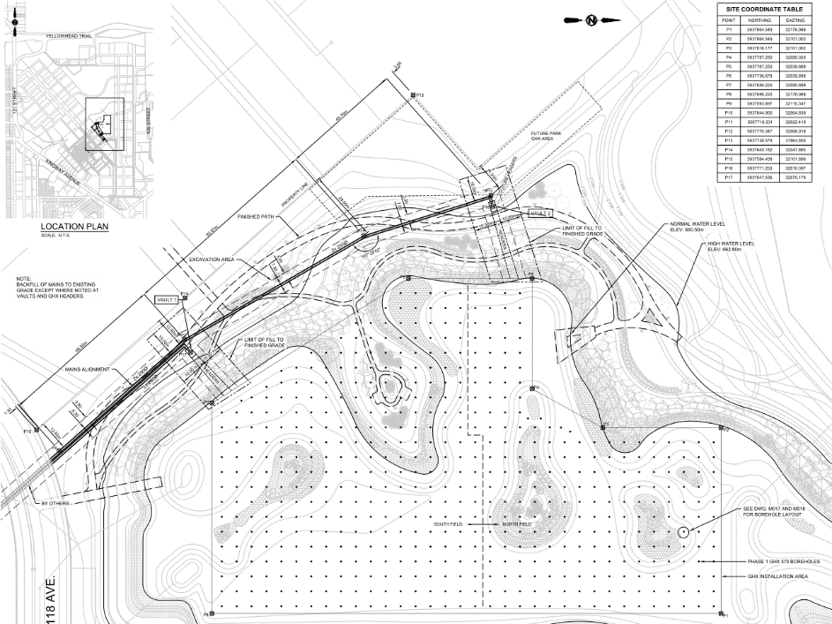
Notes:
Here is a more detailed look at the bore hole locations for the geo exchange under the lake.

Slide 23
Conservation
High Performance Buildings
Efficiency
District Energy Sharing System
Renewables
Geo-exchange Sewer Heat Exchange
Solar PV

Slide 24
Where are we today

Slide 25
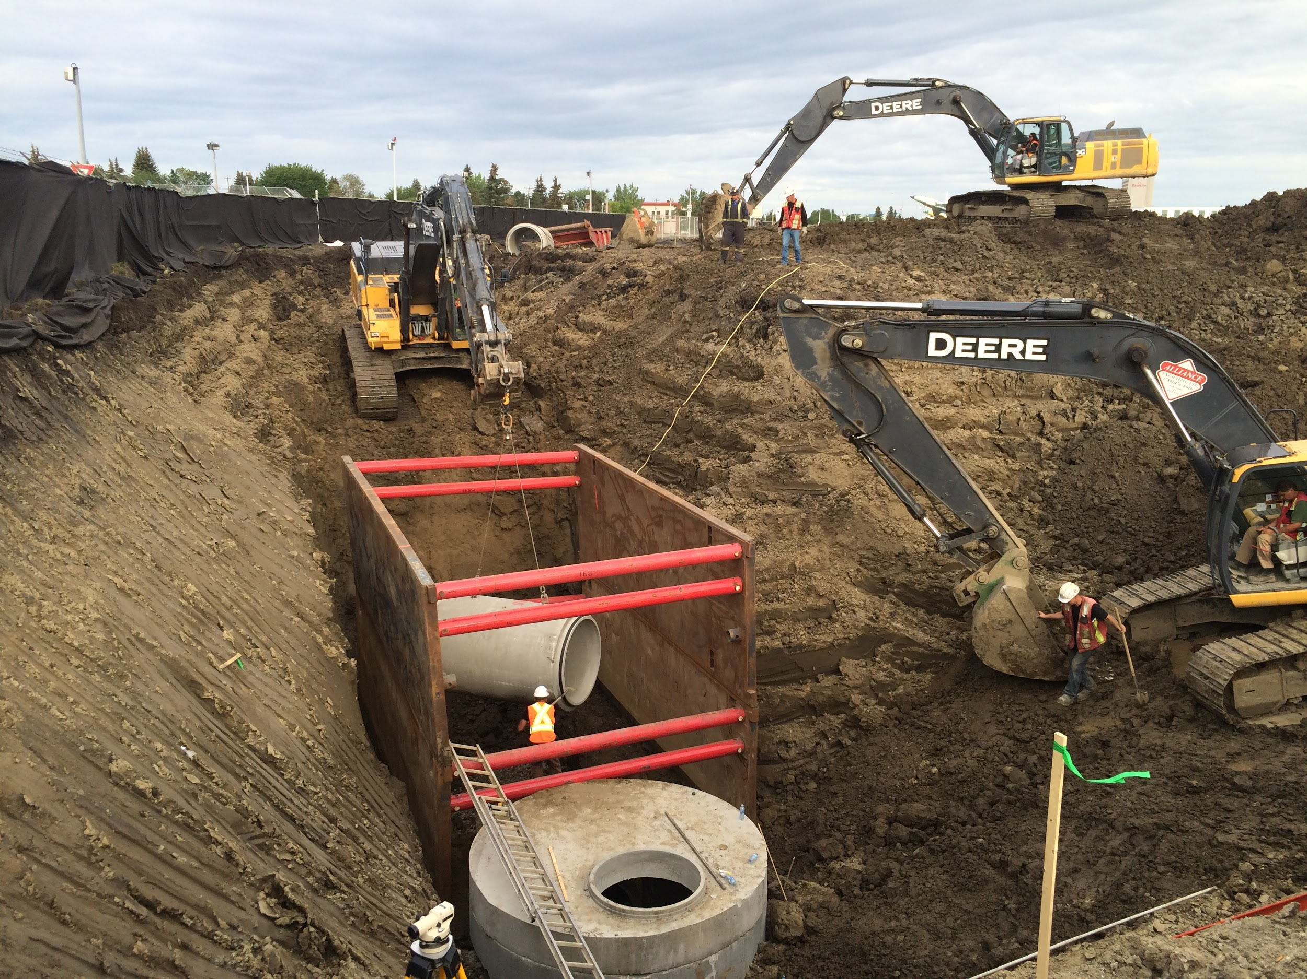
Construction
Building removal
Runway removal
Site grading
Excavation of first stormwater pond
Select portions of the storm and sanitary service connections
Stage one construction starts in 2017

Slide 26
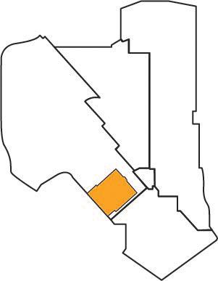
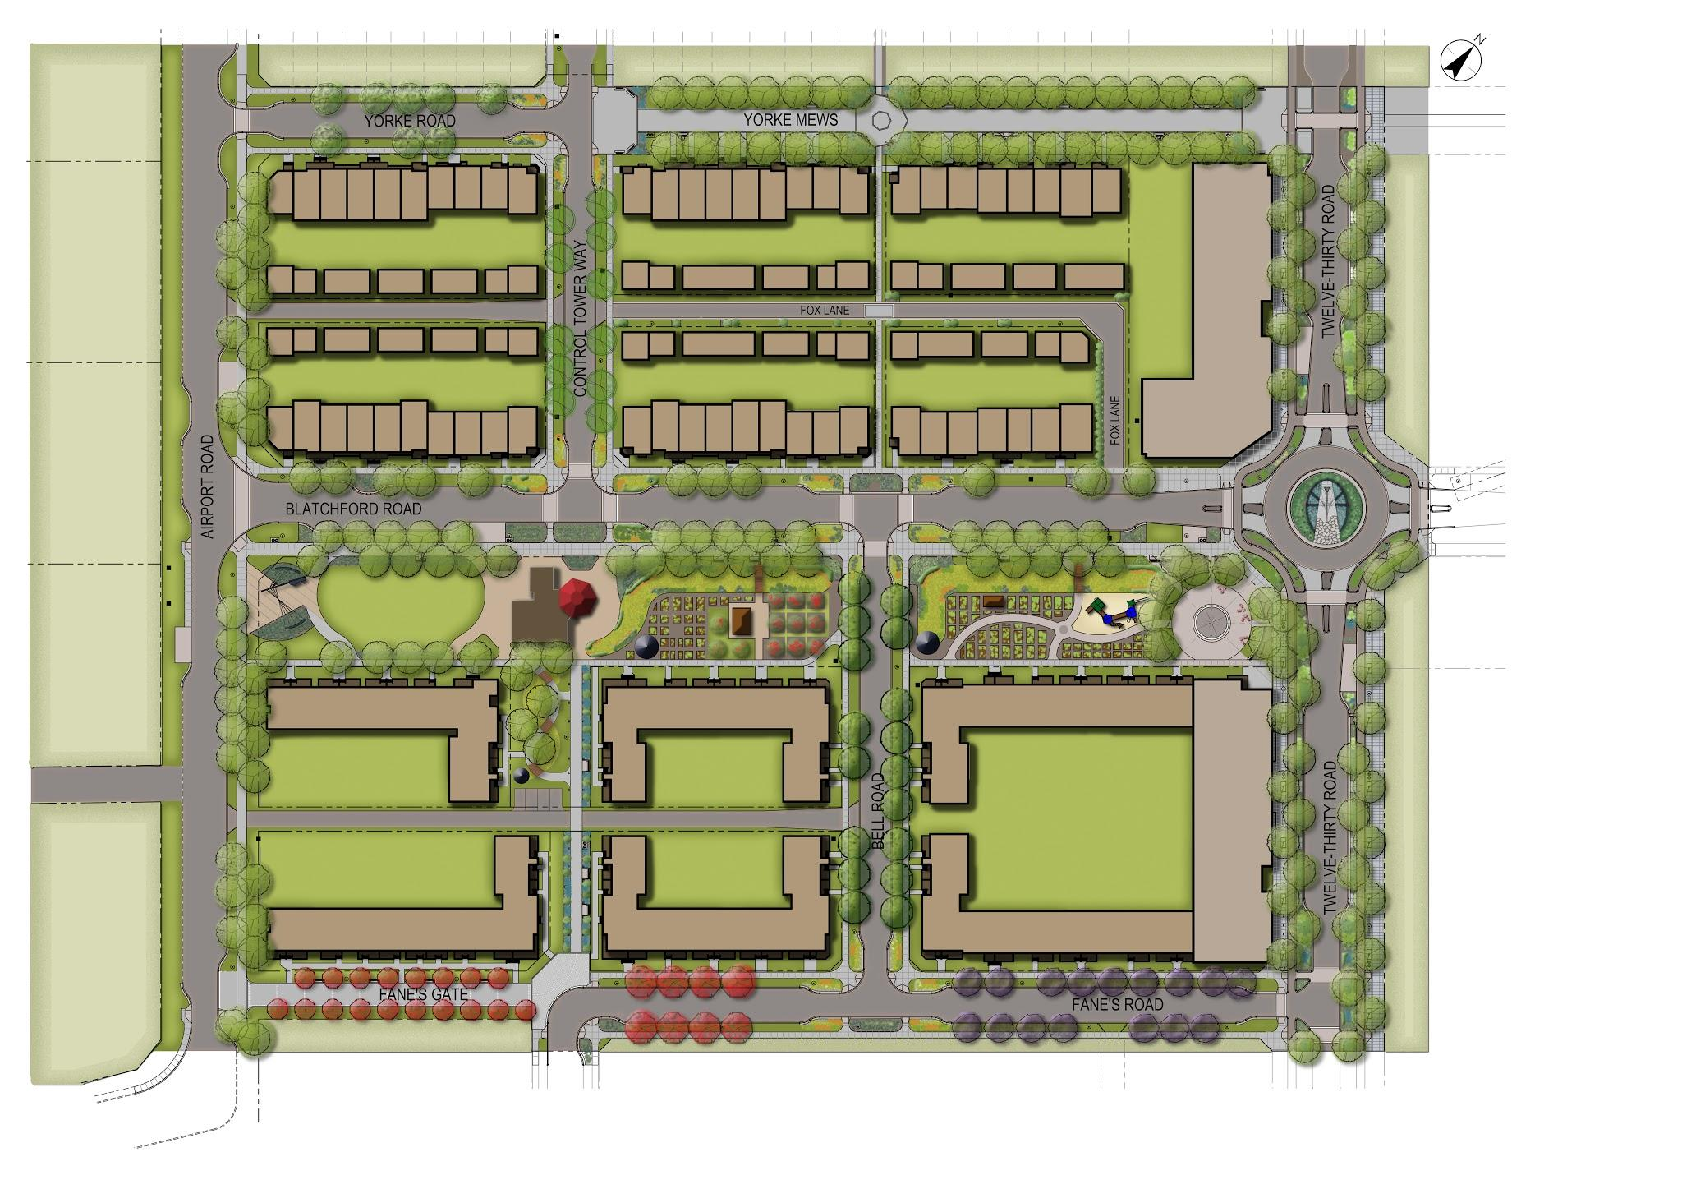
Stage one: Blatchford West
250 units
Mixed-use
Community gardens and fruit orchard
Playground
Separated bike lane
Event area
Re-purposed control tower

Slide 27
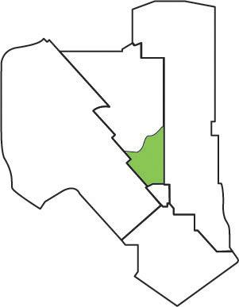
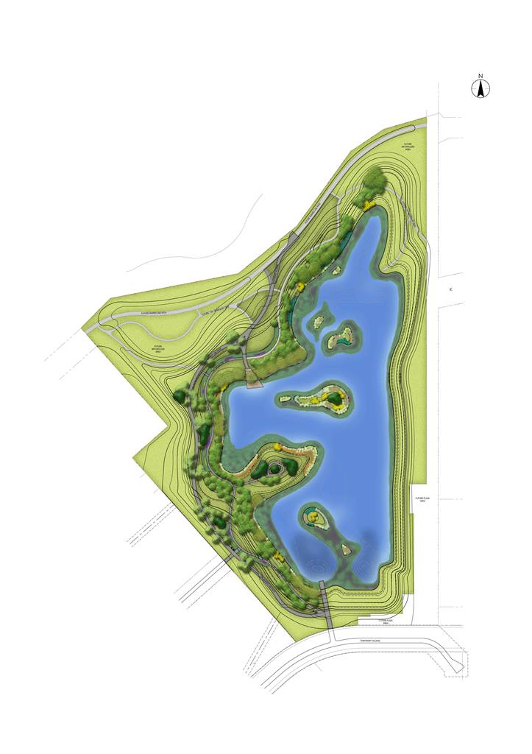
Stage one: Park
First stormwater pond
Trails
Viewing deck
Naturalized wetlands

Slide 28
Convening questions:
What (if any) additional price are buyers willing to pay to live in the Blatchford development?
i.e what is the premium for energy efficient homes, location efficiency and other sustainability amenities?
What ROI should a city be willing to accept for leadership?
How do you plan a community that will be built out over 20 or more years recognizing the significant technology advancement?

Slide 29
Exciting News!
Host City for Inaugural IPCC Cities and Climate Change Science Conference
Mark your calendars for March 4 – 7, 2018
Notes:
Context is everything …
Blatchford is an important showcase
Blatchford will be 3%

Slide 30
Edmonton’s Community Energy Transition Strategy
Blatchford Energy System
Renewable Cities - Global Learning Forum 2017
May 18, 2017
Mark Brostrom

