Slide 1
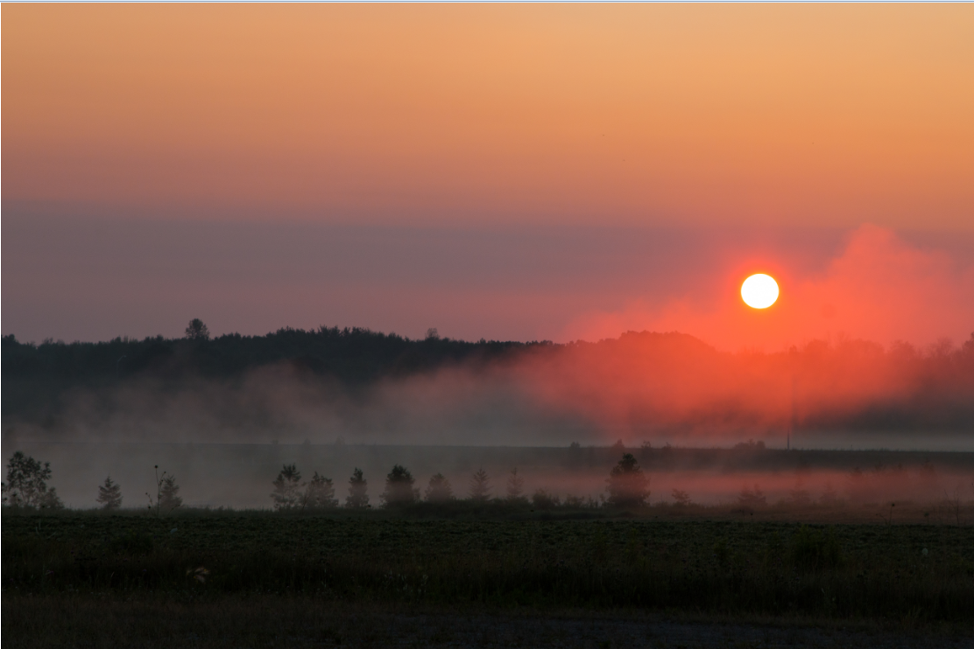

Jay Heaman
Manager, Strategic Initiatives
Oxford County, Ontario Canada
Our transition to 100% renewable energy
Renewable Cities 2017
Building Blocks for a 100%RE Transformation

Slide 2

The genesis of a community sustainability plan

Slide 3

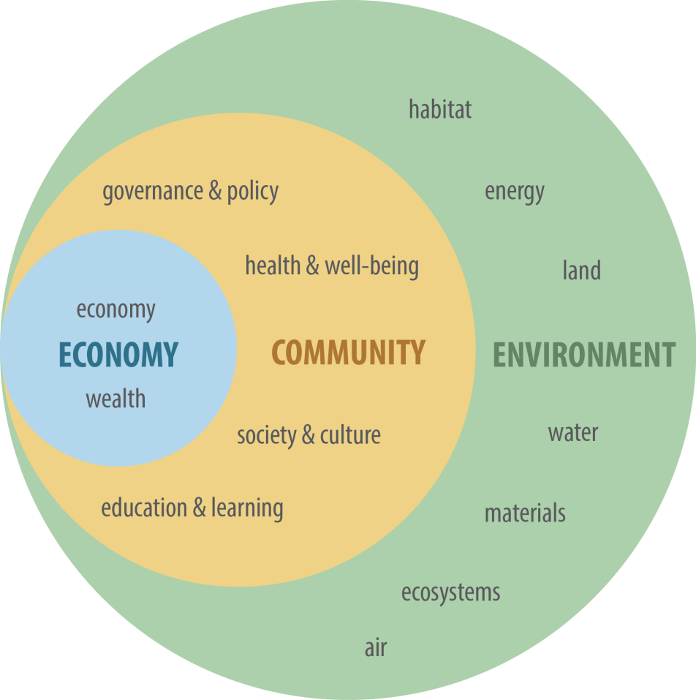

The genesis of a community sustainability plan

Slide 4
The genesis of a community sustainability plan

Slide 5
Creating a network of support
Community
Business
Government
Provincial & federal
Academic
National Partners
International Partners

Slide 6
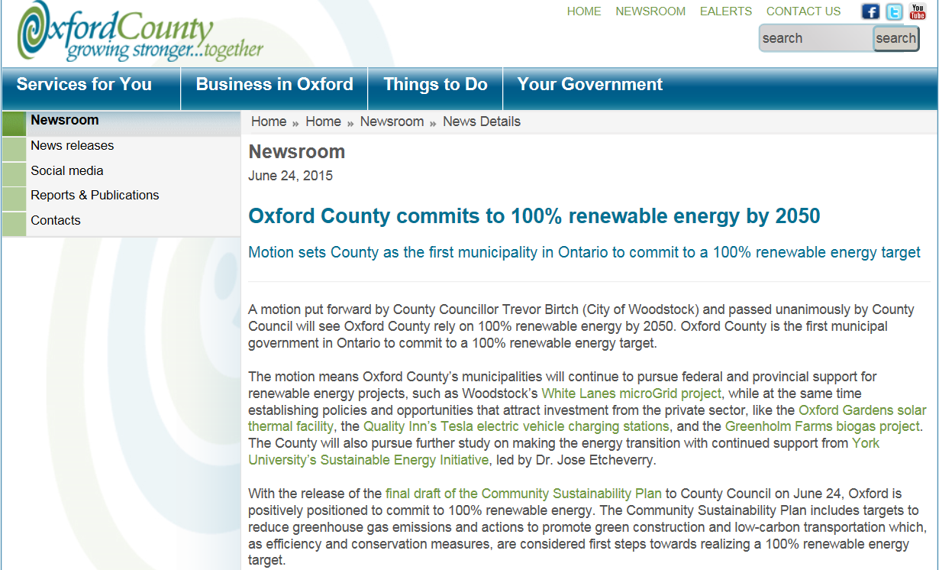
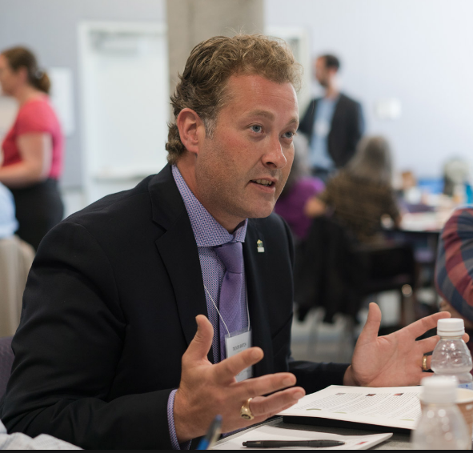
100% renewable energy by 2050 Motion of council

Slide 7
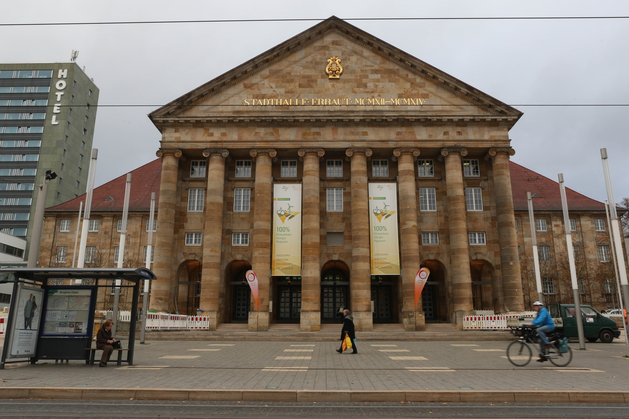
Fall 2015 – Kassel 100% RE forum

Slide 8
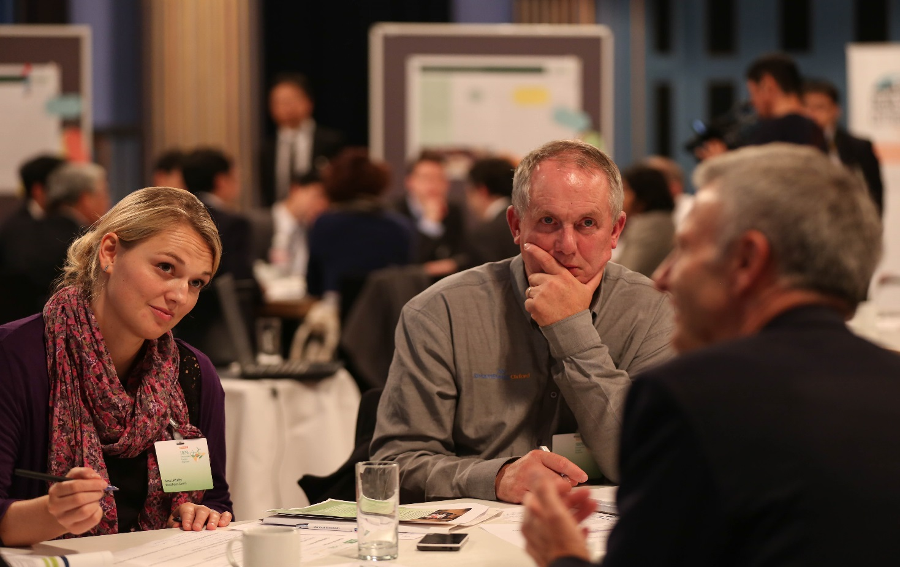
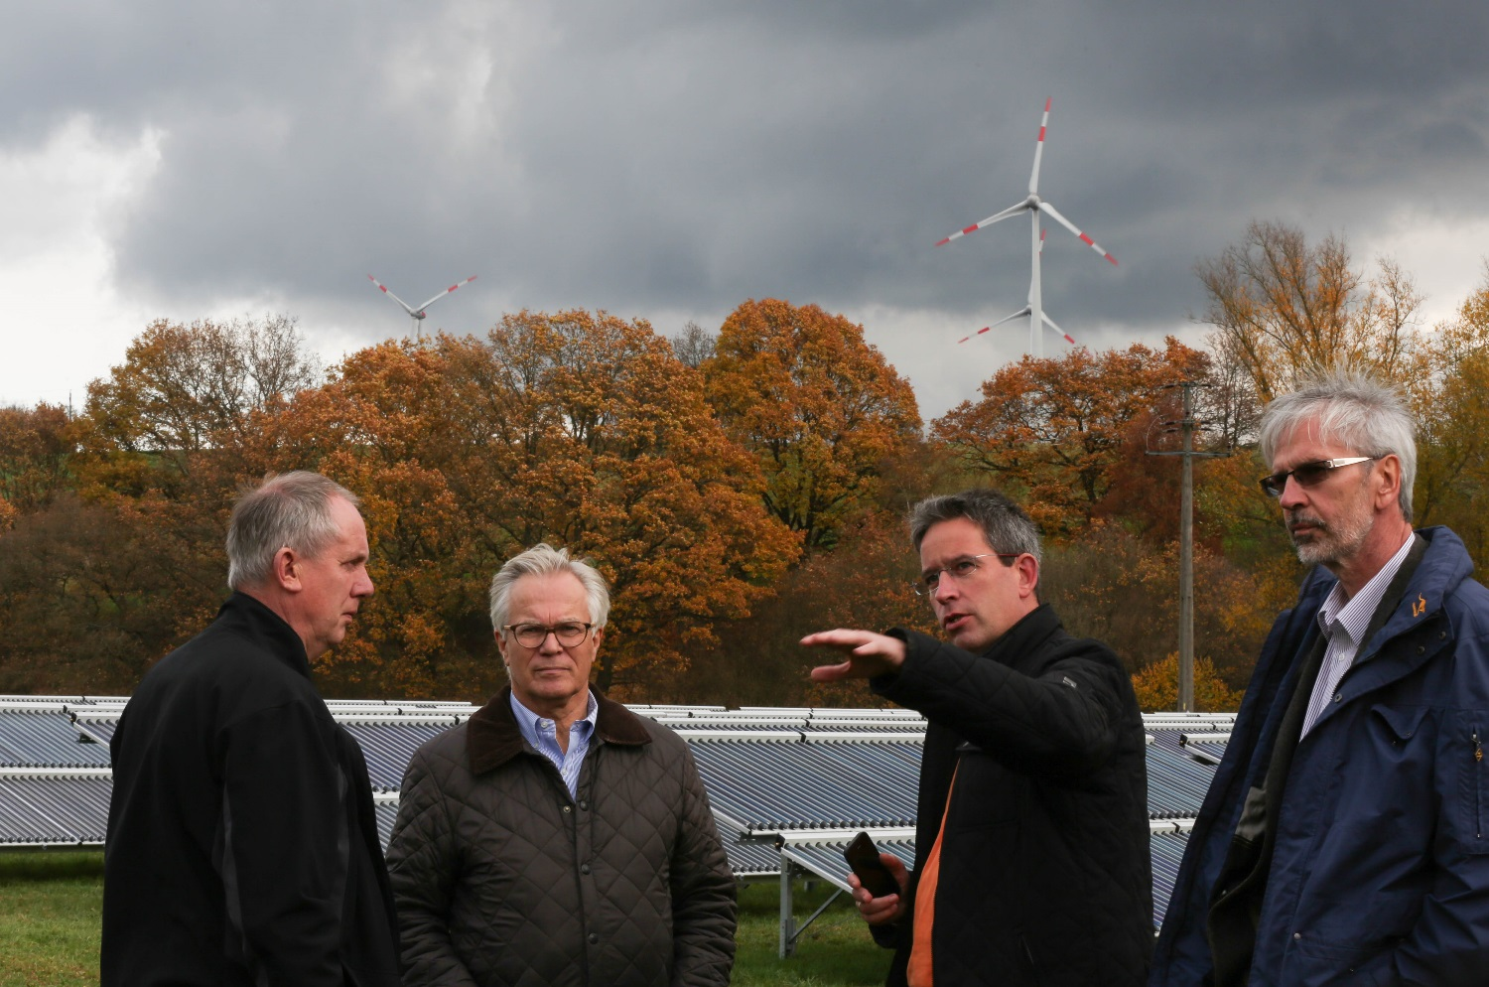
Fall 2015 – Kassel 100% RE forum

Slide 9
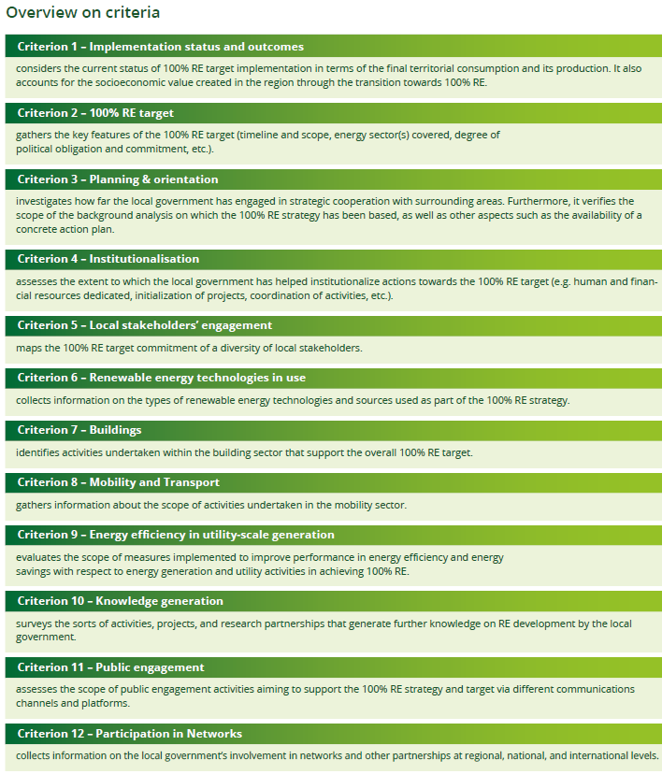
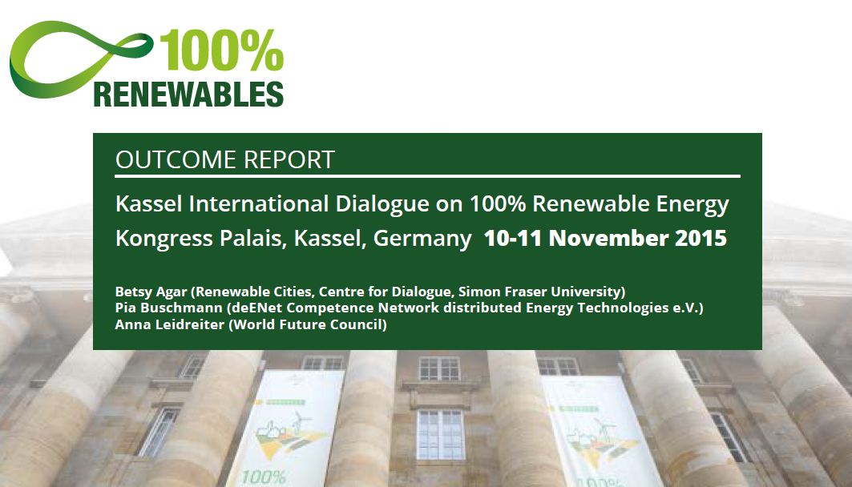
Fall 2015 – Kassel 100% RE forum

Slide 10

Early 2016 – 100% RE planning

Slide 11



Early 2016 – 100% RE planning
Notes:
https://www.youtube.com/watch?v=vZwUCBf-_g4

Slide 12


Early 2016 – 100% RE planning
Notes:
https://www.youtube.com/watch?v=vZwUCBf-_g4

Slide 13
Summer 2016 - implementation
Identify components:
  Transportation, Buildings, Electricity
Establish Baseline:
  Create as close to ‘real-time’ as possible (IESO Smart metering data, for example)
Create Pilot Projects:
  Engage stakeholders through pilots, innovation cluster discussion and research through to implementation

Slide 14
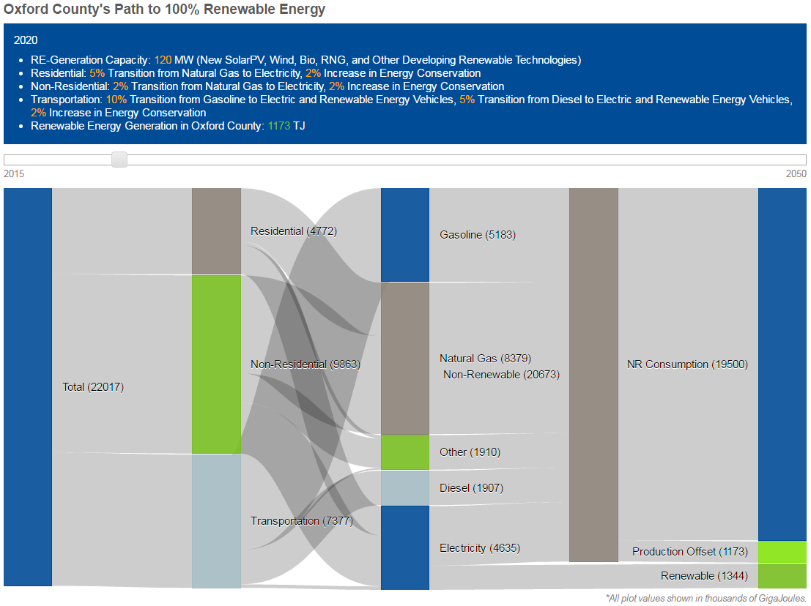
Fall 2016 – baseload energy information

Slide 15
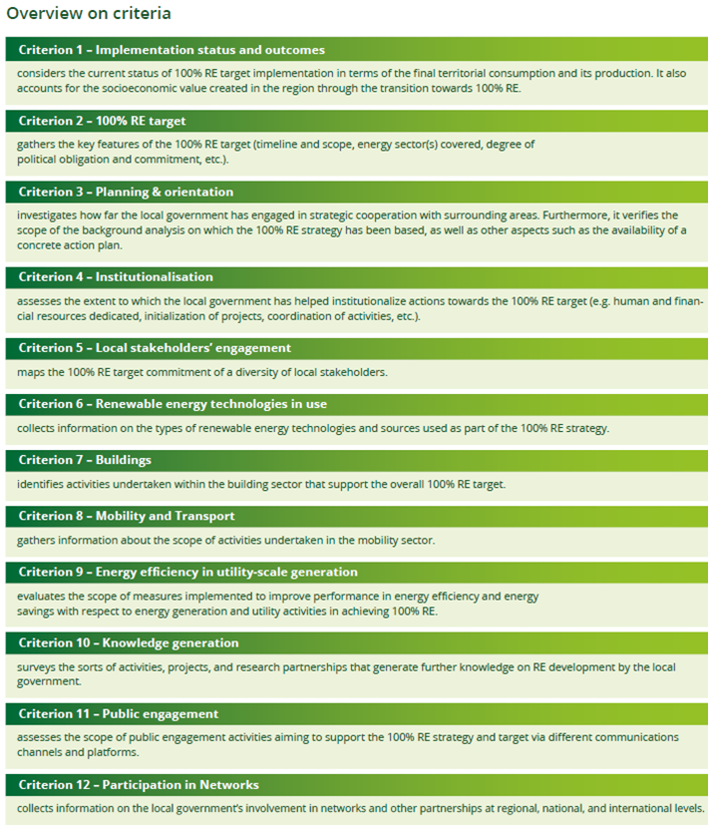

Ensuring we maintain a consistent approach globally

Slide 16
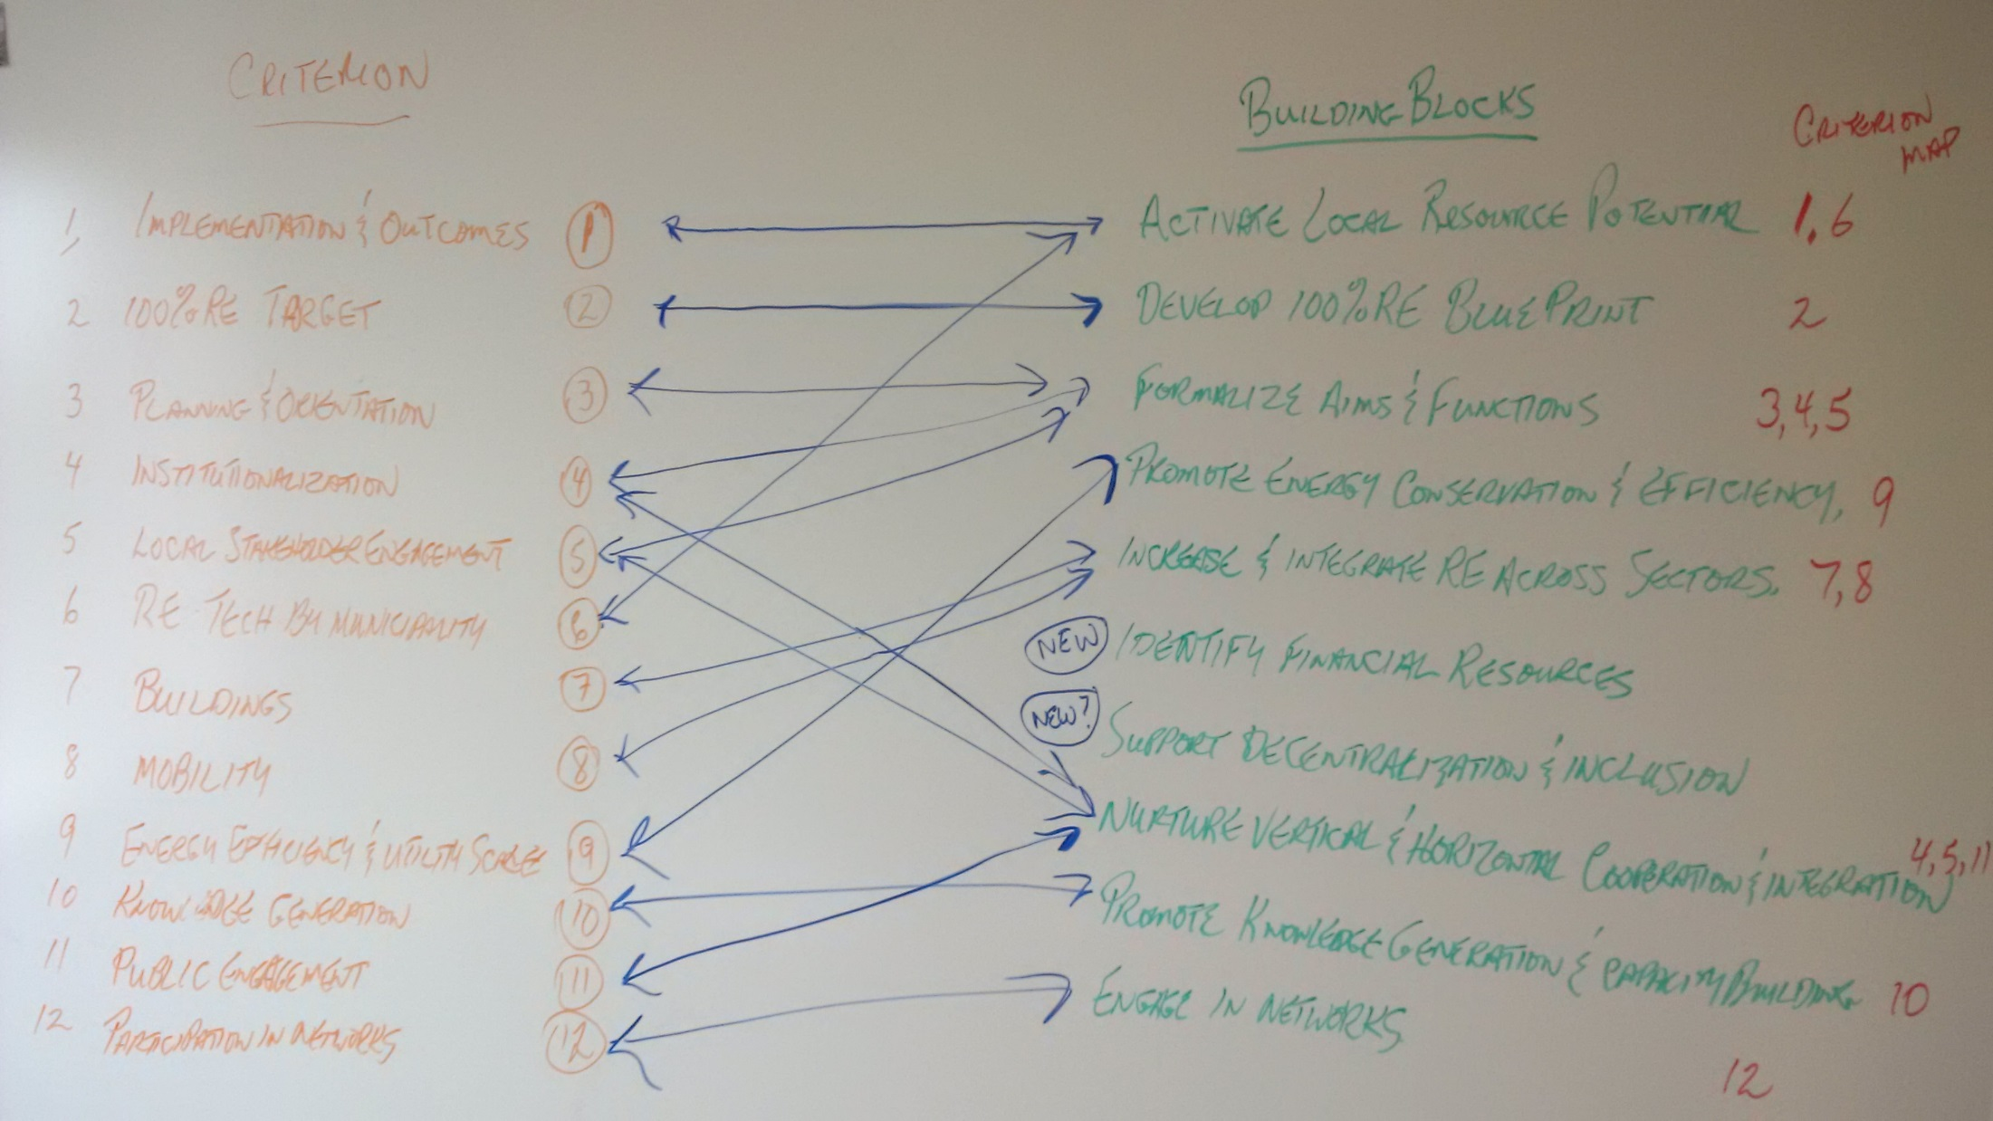
Ensuring we maintain a consistent approach globally

Slide 17
Ensuring we maintain a consistent approach globally

