Slide 1
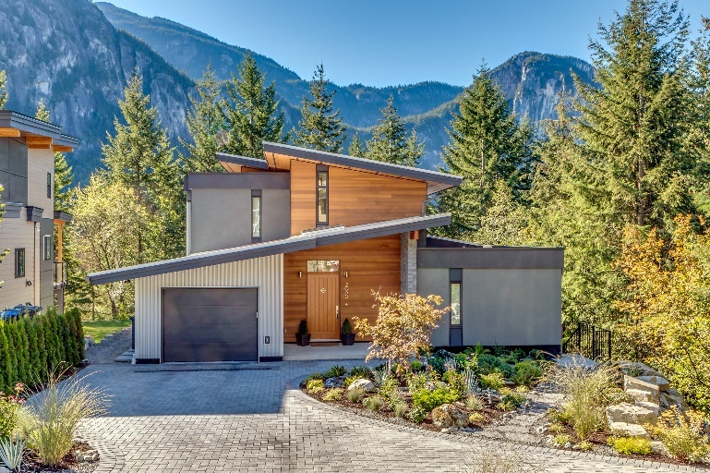
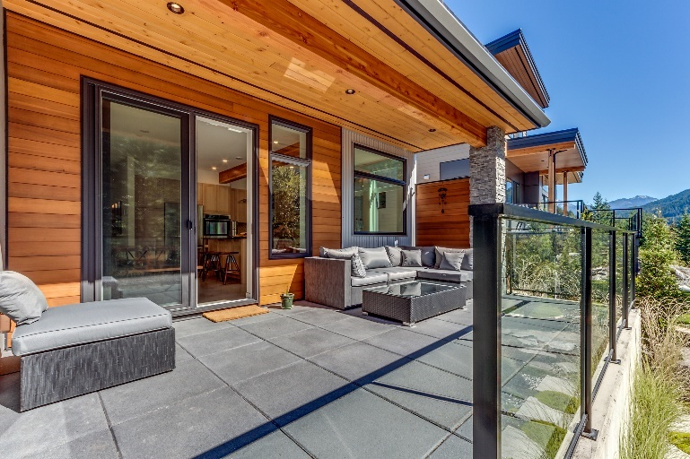
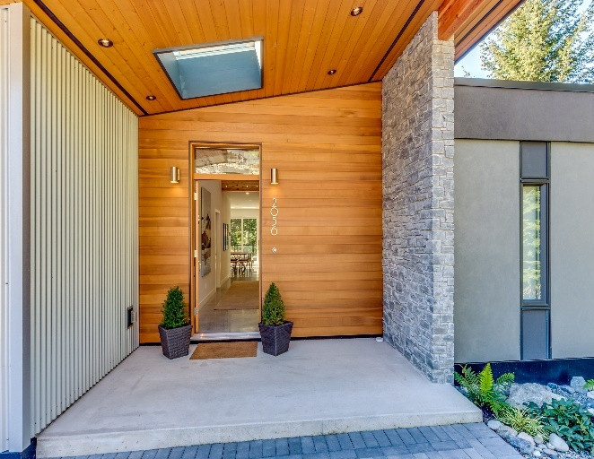
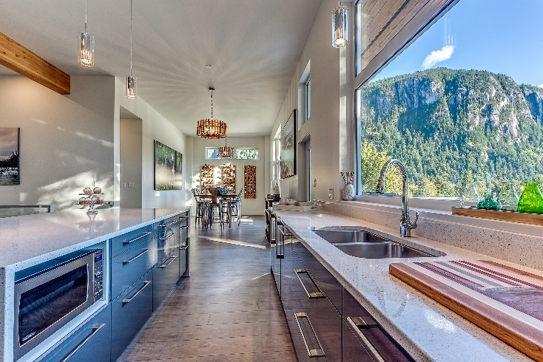
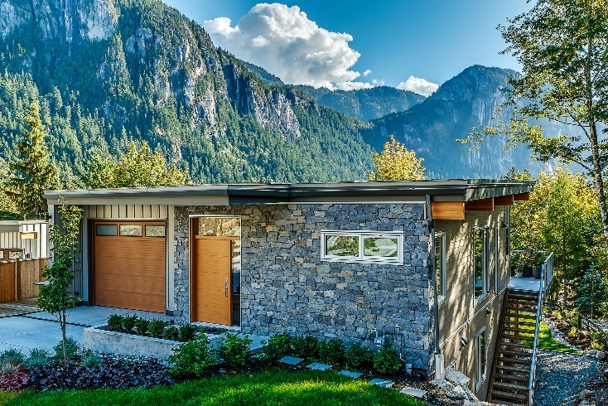
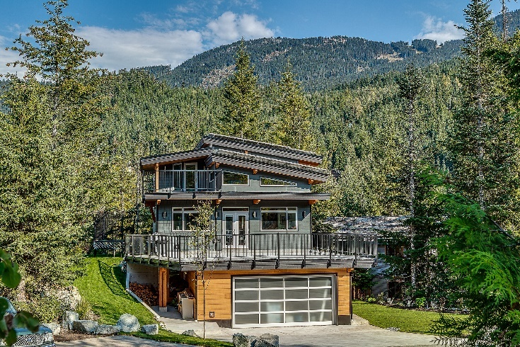
Step Code and Net Zero Energy Housing Presented by Bob Deeks| President RDC Fine Homes For Renewable Cities Energy Step Code Session| May 18, 2017

Slide 2
Housing technology has come a long way!
Do you want a home built to the standards of the past…
Notes:
Talk about drafts, mold/smelly basements, noise, condensation

Slide 3
A new home should represent the best of today’s technology
Or the home of the future built today:
Comfortable
Healthy
Quiet
Durable
Energy Efficient
Notes:
Benefit slides to come…

Slide 4
Opportunities in Todays Market
Step Code offers a phased approach to achieve Net Zero
Generally aligned with current certification options

Slide 5
Current Programs in place

Slide 6
Current Market Demand
CHBA 2016 New Home Buyer Survey:
Out of the top 10 must haves 4 were for energy efficiency
#2 Energy efficient appliances
#3 Energy efficient windows
#5 Overall energy efficiency
#10 HRV/ERV

Slide 7
Transformation Barriers
Working together we can grow the industry:
Capacity
Education
Consumer demand
Incentives

Slide 8
From Here to There

Slide 9
CHBA Net Zero Label
Building capacity across Canada
Industry engagement – net zero Council
Education
Builders
Realtors
Financial institutions

